Slide 1
Instructions how to fill in the ESPD
Former: Self-Declaration form
Stephan Scheeren
21-07-2016

Slide 2
Instructions on how to fill in the ESPD
ESPD = European Single Procurement Document.
This document has replaced the so called Self Declaration Form in the European Tendering procedures.
So it is no longer necessary to fill the Self Declaration form. Now this ESPD will suffice.
In this Instruction-document it is explained how to use the ESPD (XML-file; Annex 21).

Slide 3
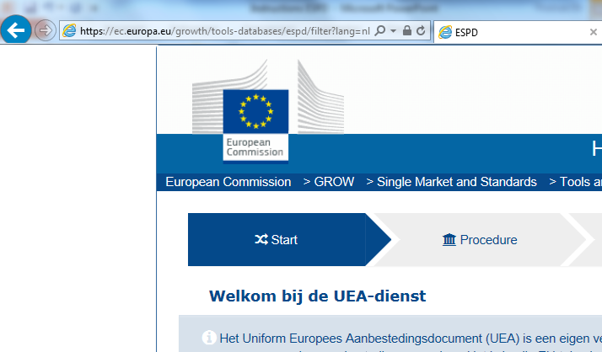
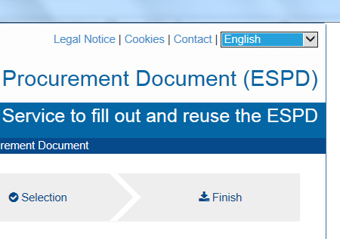
Instruction (1)
Start by opening your webbrowser
  (e.g. Internet Explorer, Windows Edge, Google Chrome)
Copy the following link into your browser
  https://ec.europa.eu/growth/tools-databases/espd/filter?lang=nl
Choose your language at the top – right side of the browser.

Slide 4
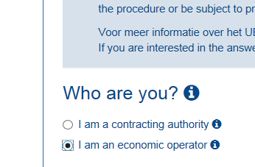
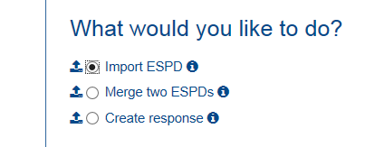
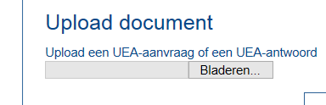
Instruction (2)
Select the following
  English: I am an economic operator
  Dutch: Ik ben een ondernemer
Select the following
  English: Import ESPD
  Dutch: Een UEA importeren
Upload the XML-document; Annex 21

Slide 5
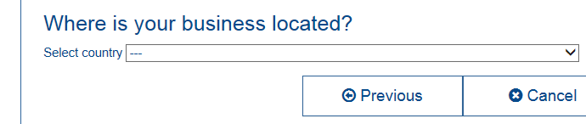
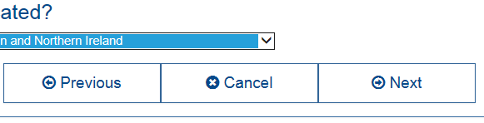
Instruction (3)
Select your country
Click “Next”

Slide 6
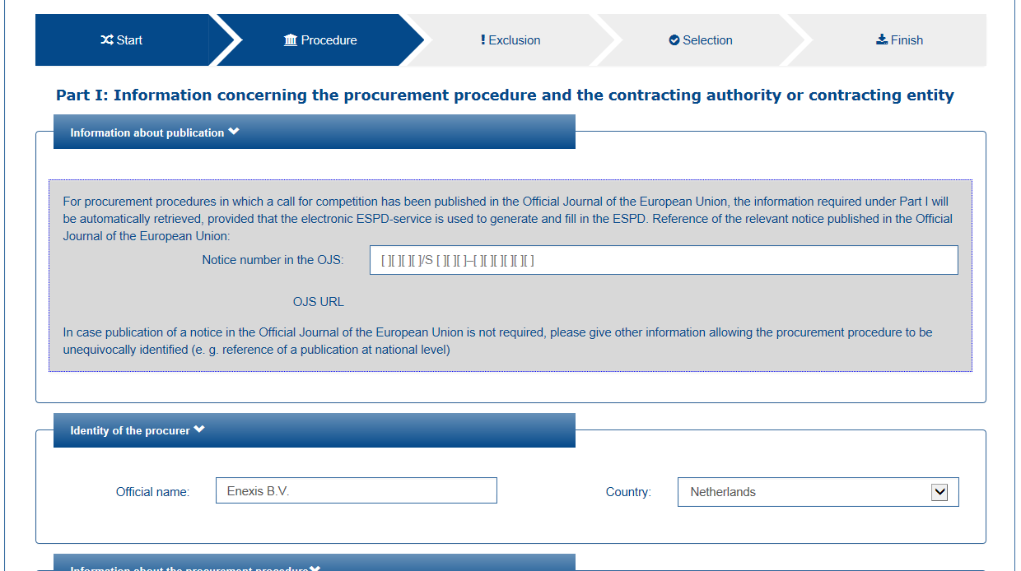
Dia met opsommingstekst
Now the ESPD opens and can be completed by following the instructions on the screen.

Slide 7


