Slide 1
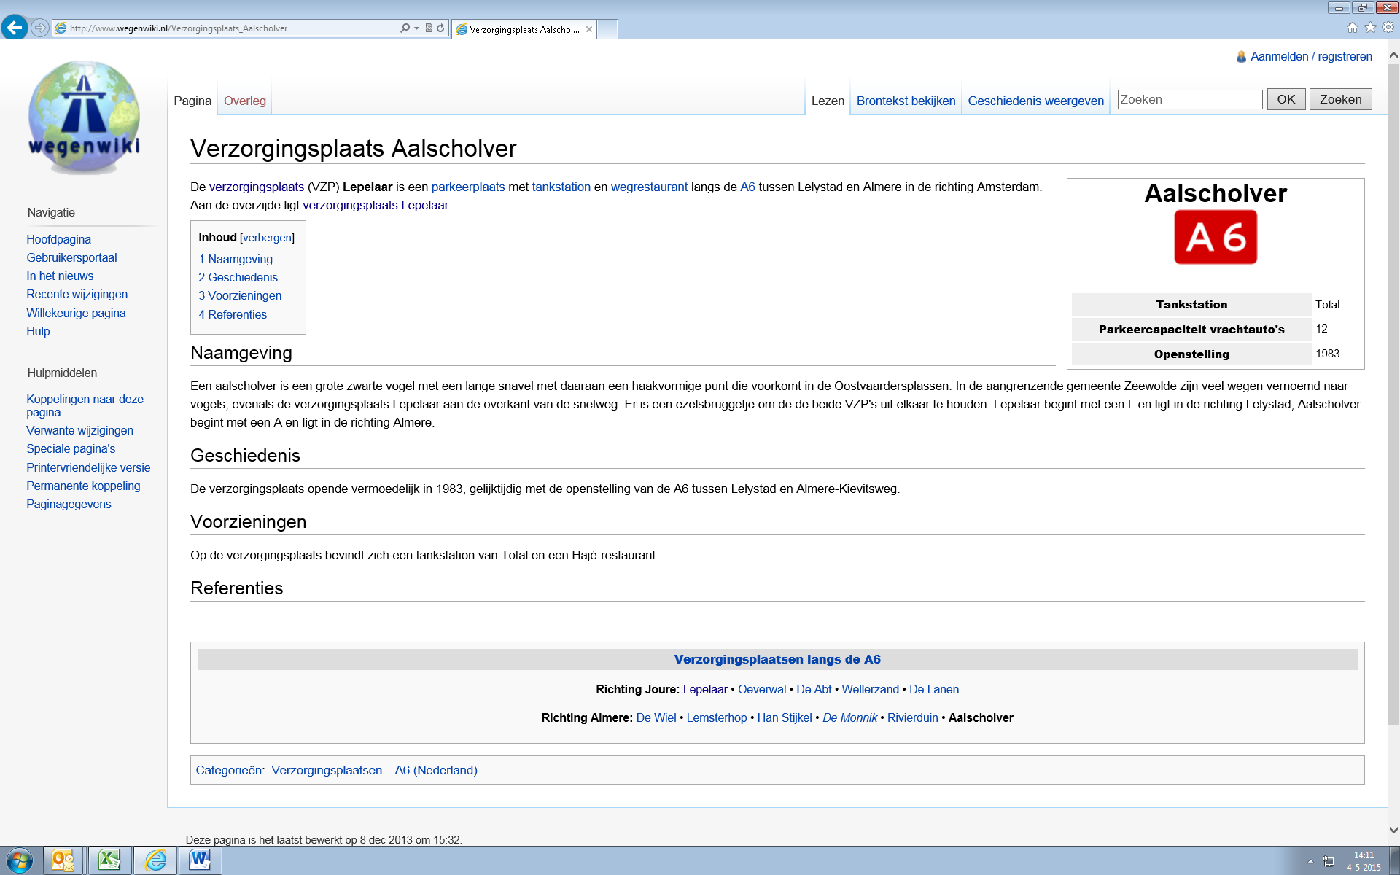
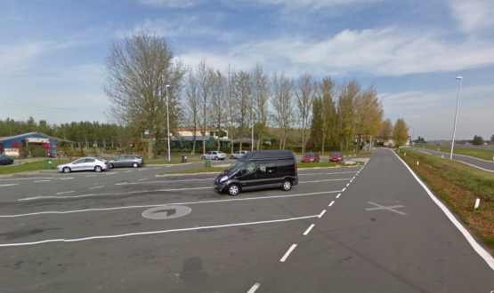
Restaurant: HAJE
Tankstation: Total

Slide 2

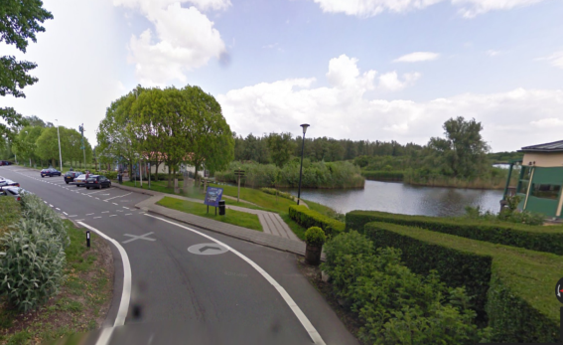
Restaurant: HAJE
Tankstation: Total

Slide 3
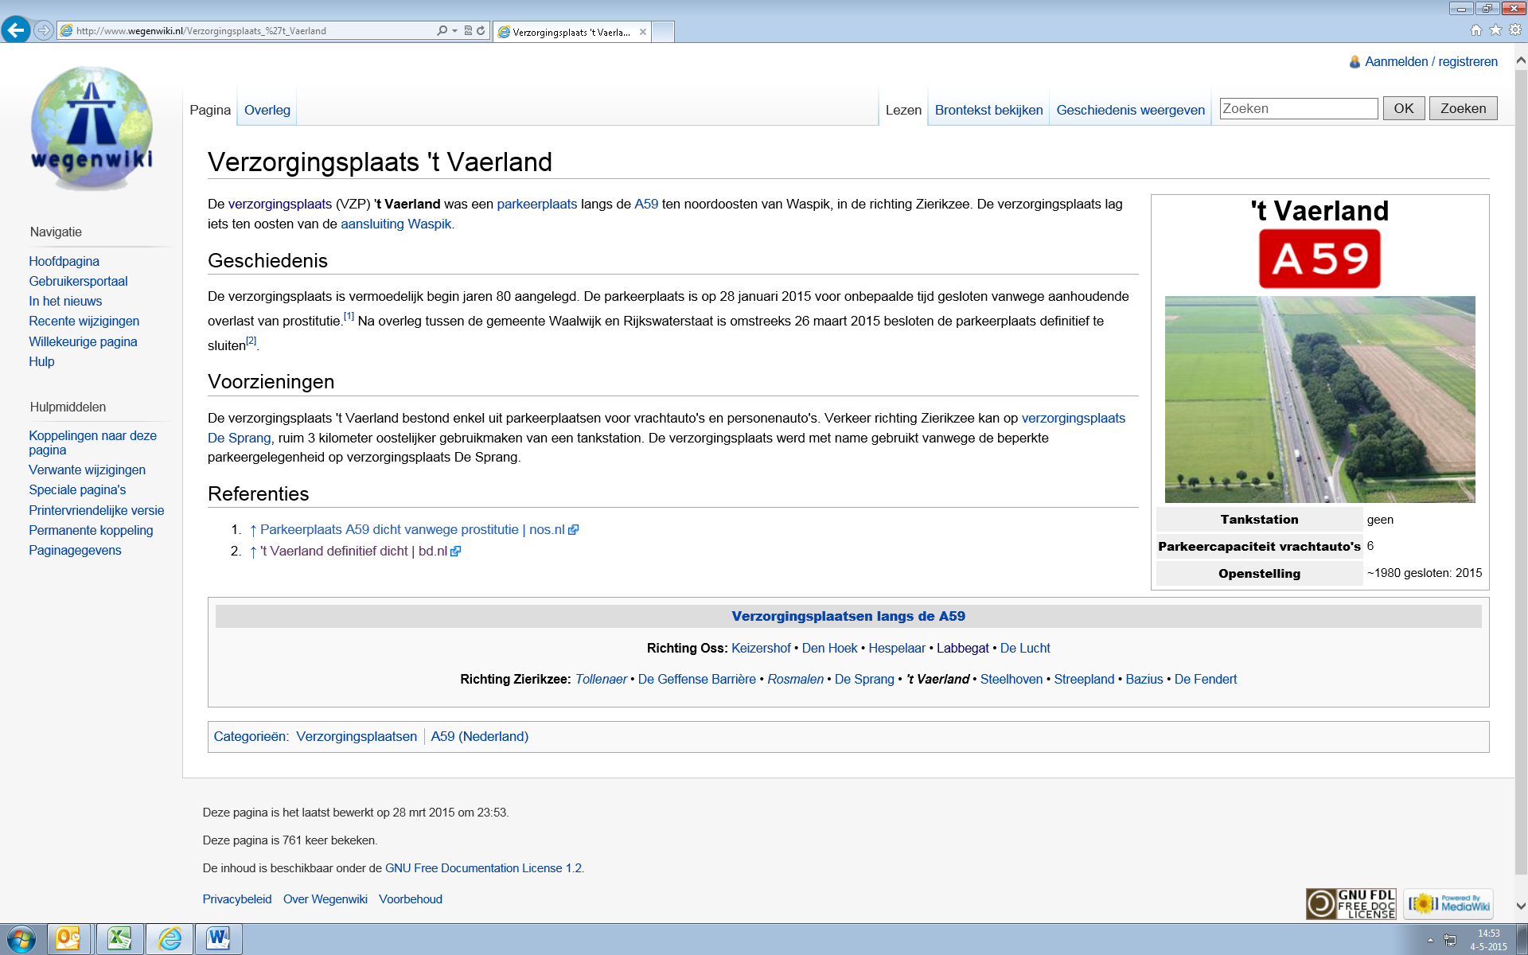
Restaurant: NVT
Tankstation: NVT

Slide 4
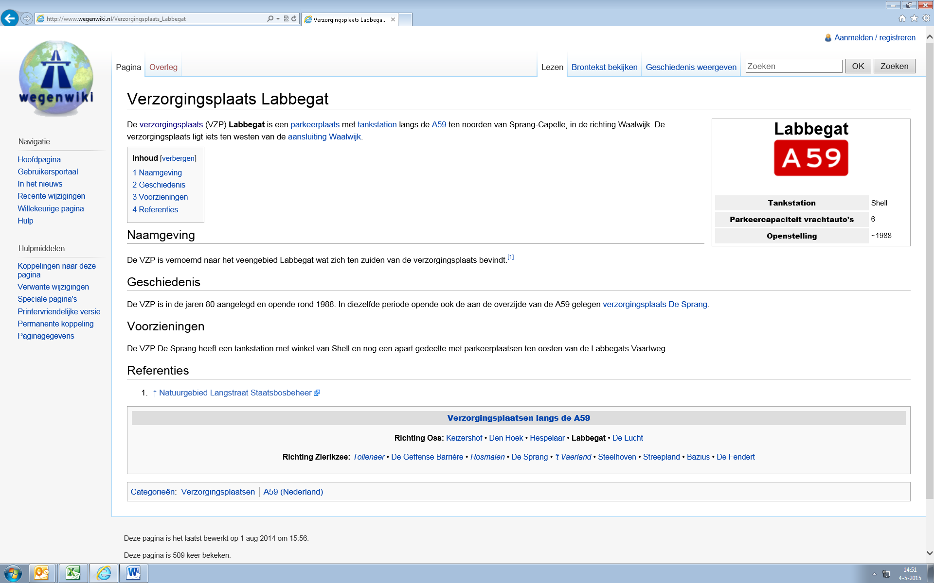
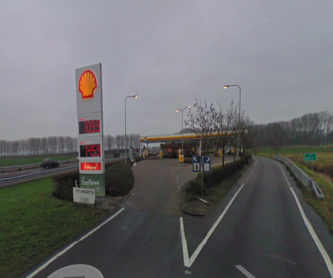
Restaurant: NVT
Tankstation: Shell

Slide 5
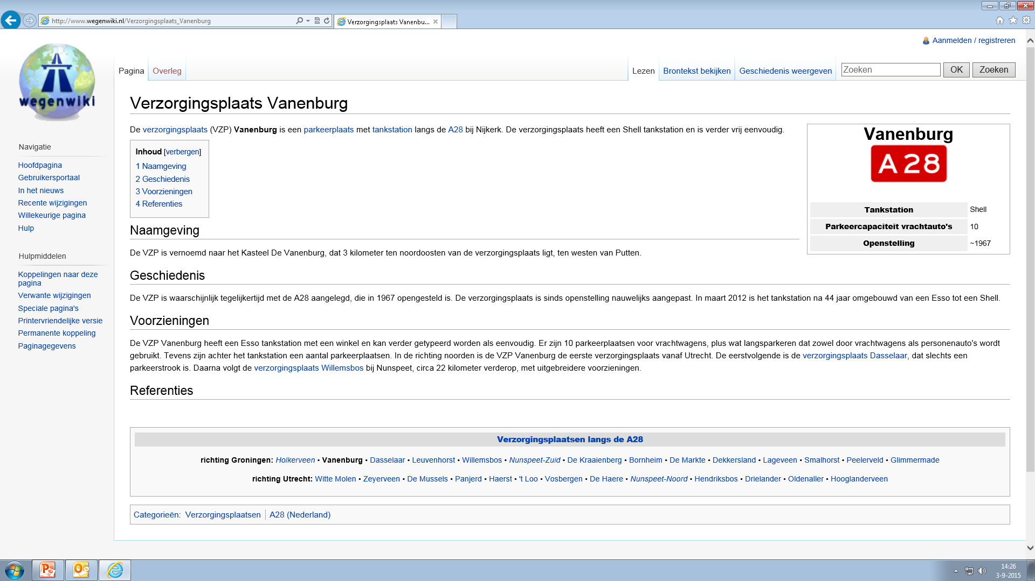
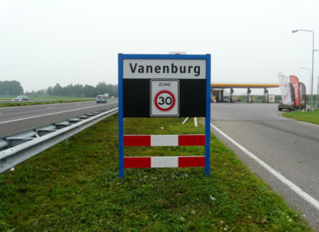
Restaurant: NVT
Tankstation: Shell

Slide 6
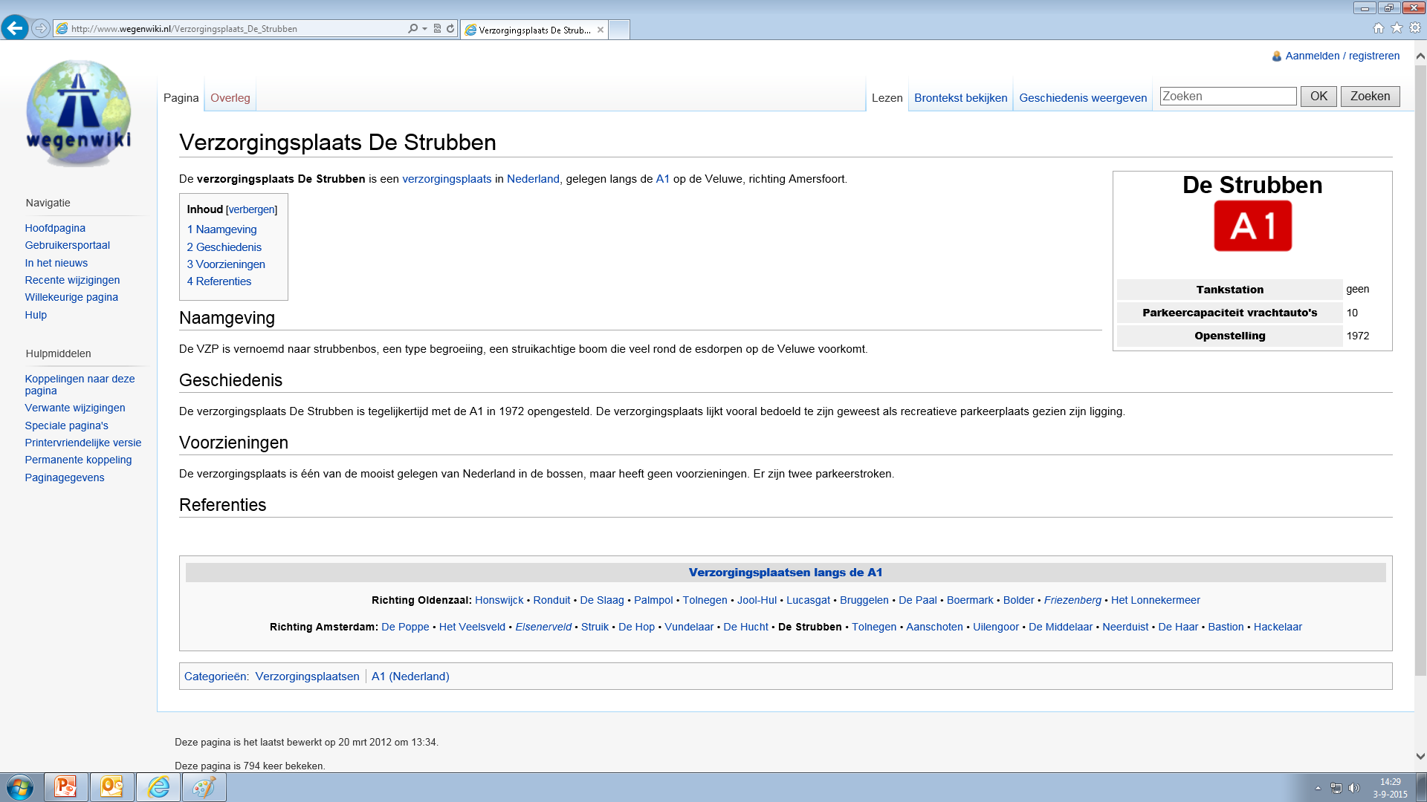
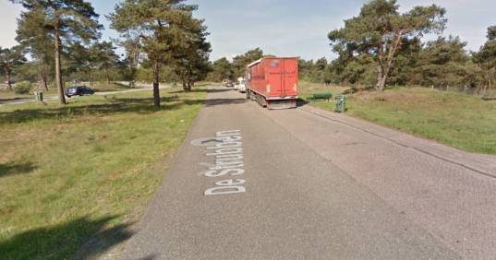
Restaurant: NVT
Tankstation: NVT

