Slide 1
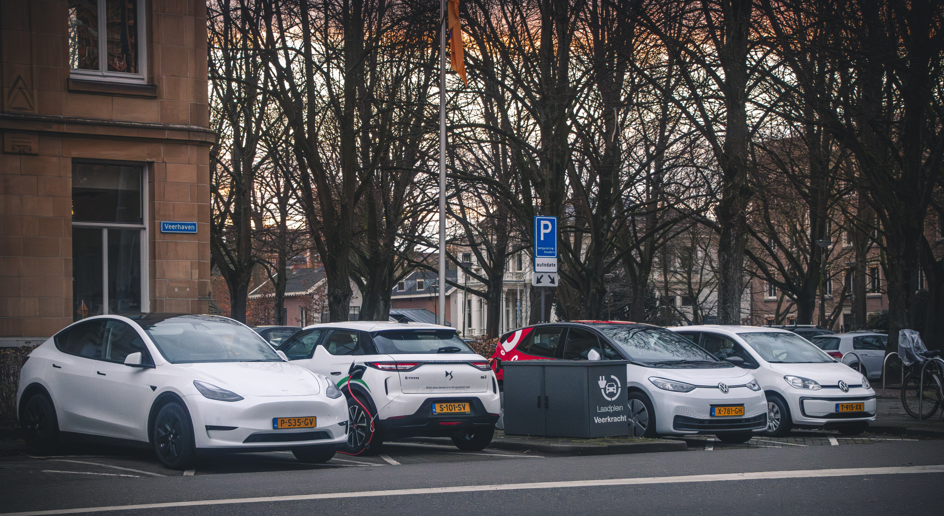
Bijlage 3. Fasering woningbouwprojecten in Ede-Centrum en locaties deelmobiliteithubs (deelbakfietsen)

Slide 2
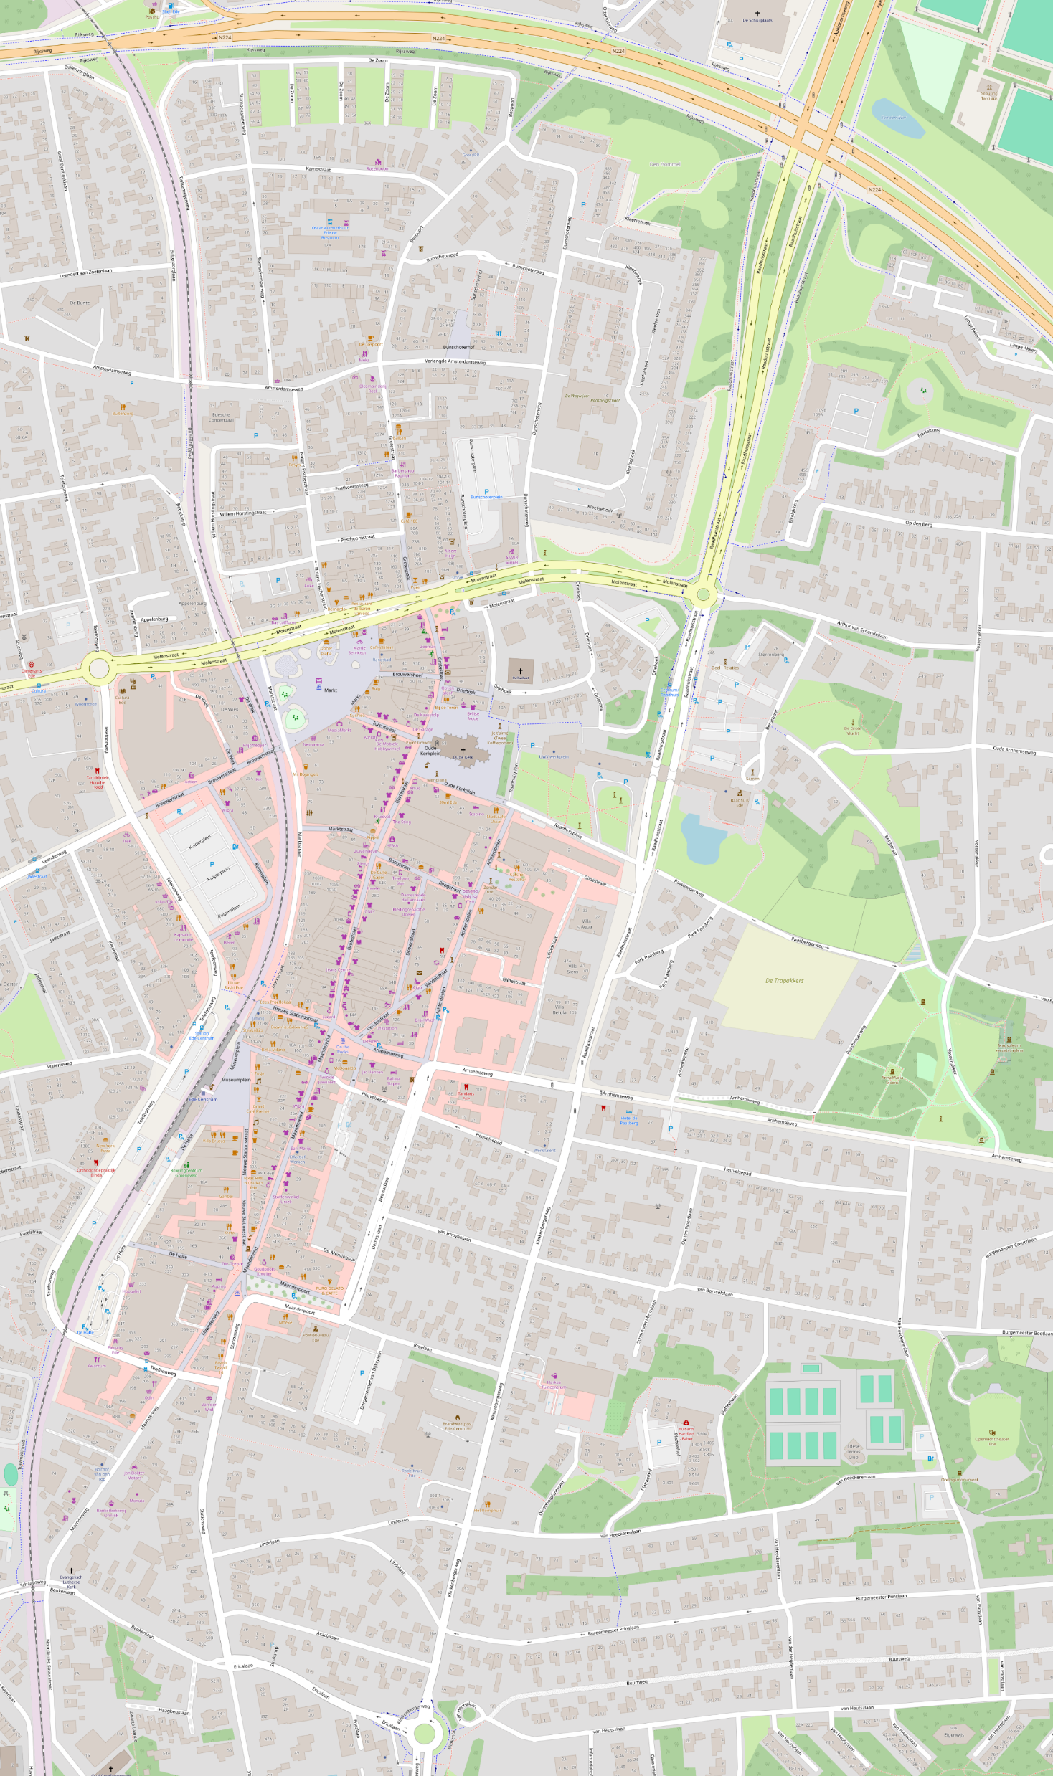
2027
60 woningen
Planning: 2027
5 woningen
Planning: 2027
1 woning
Planning: 2025
26 woningen
Planning: 2026
15 woningen
Planning: 2026
14 woningen
Planning: 2026
11 woningen
Planning: 2027
6 woningen
Planning: 2027
9 woningen
Planning: 2027
6 woningen
Planning: 2026
34 woningen
Planning: 2027
18 woningen
Planning: 2027
11 woningen
Planning: 2027
41 woningen
Planning: 2027
11 woningen
Planning: 2027
49 woningen
Planning: 2027
9 woningen
Planning: 2027
75 woningen
Planning: 2026

Slide 3
2028
60 woningen
Planning: 2027
5 woningen
Planning: 2027
1 woning
Planning: 2025
26 woningen
Planning: 2026
60 woningen
Planning: 2028
26 woningen
Planning: 2028
30 woningen
Planning: 2028
15 woningen
Planning: 2026
14 woningen
Planning: 2026
11 woningen
Planning: 2027
6 woningen
Planning: 2027
9 woningen
Planning: 2027
6 woningen
Planning: 2026
34 woningen
Planning: 2027
9 woningen
Planning: 2028
18 woningen
Planning: 2027
11 woningen
Planning: 2027
74 woningen
Planning: 2028
5 woningen
Planning: 2028
41 woningen
Planning: 2027
11 woningen
Planning: 2027
49 woningen
Planning: 2027
9 woningen
Planning: 2027
75 woningen
Planning: 2026

Slide 4
2029
60 woningen
Planning: 2027
5 woningen
Planning: 2027
1 woning
Planning: 2025
26 woningen
Planning: 2026
60 woningen
Planning: 2028
26 woningen
Planning: 2028
30 woningen
Planning: 2028
15 woningen
Planning: 2026
14 woningen
Planning: 2026
11 woningen
Planning: 2027
55 woningen
Planning: 2029
6 woningen
Planning: 2027
9 woningen
Planning: 2027
6 woningen
Planning: 2026
34 woningen
Planning: 2027
9 woningen
Planning: 2028
18 woningen
Planning: 2027
11 woningen
Planning: 2027
74 woningen
Planning: 2028
16 woningen
Planning: 2029
5 woningen
Planning: 2028
41 woningen
Planning: 2027
11 woningen
Planning: 2027
49 woningen
Planning: 2027
9 woningen
Planning: 2027
75 woningen
Planning: 2026

Slide 5
2030+
90 woningen
Planning: 2030+
60 woningen
Planning: 2027
5 woningen
Planning: 2027
1 woning
Planning: 2025
26 woningen
Planning: 2026
60 woningen
Planning: 2028
26 woningen
Planning: 2028
30 woningen
Planning: 2028
15 woningen
Planning: 2026
14 woningen
Planning: 2026
20 woningen
Planning: 2030
11 woningen
Planning: 2027
55 woningen
Planning: 2029
6 woningen
Planning: 2027
9 woningen
Planning: 2027
6 woningen
Planning: 2026
34 woningen
Planning: 2027
36 woningen
Planning: 2030
40 woningen
Planning: 2030
9 woningen
Planning: 2028
24 woningen
Planning: 2030
18 woningen
Planning: 2027
55 woningen
Planning: 2030+
11 woningen
Planning: 2027
74 woningen
Planning: 2028
18 woningen
Planning: 2030
16 woningen
Planning: 2029
5 woningen
Planning: 2028
41 woningen
Planning: 2027
100 woningen
Planning: 2030
11 woningen
Planning: 2027
32 woningen
Planning: 2030
49 woningen
Planning: 2027
9 woningen
Planning: 2027
75 woningen
Planning: 2026

Slide 6
2027
Basisaanbod hubs
60 woningen
Planning: 2027
Zoeklocaties hubs
5 woningen
Planning: 2027
1 woning
Planning: 2025
26 woningen
Planning: 2026
1
15 woningen
Planning: 2026
14 woningen
Planning: 2026
11 woningen
Planning: 2027
6 woningen
Planning: 2027
9 woningen
Planning: 2027
6 woningen
Planning: 2026
34 woningen
Planning: 2027
4
18 woningen
Planning: 2027
11 woningen
Planning: 2027
2
41 woningen
Planning: 2027
11 woningen
Planning: 2027
49 woningen
Planning: 2027
9 woningen
Planning: 2027
3
75 woningen
Planning: 2026

Slide 7
2028
Basisaanbod hubs
60 woningen
Planning: 2027
Zoeklocaties hubs
5 woningen
Planning: 2027
1 woning
Planning: 2025
26 woningen
Planning: 2026
60 woningen
Planning: 2028
26 woningen
Planning: 2028
30 woningen
Planning: 2028
1
15 woningen
Planning: 2026
14 woningen
Planning: 2026
5
11 woningen
Planning: 2027
6 woningen
Planning: 2027
9 woningen
Planning: 2027
6 woningen
Planning: 2026
34 woningen
Planning: 2027
4
9 woningen
Planning: 2028
18 woningen
Planning: 2027
11 woningen
Planning: 2027
74 woningen
Planning: 2028
2
5 woningen
Planning: 2028
41 woningen
Planning: 2027
11 woningen
Planning: 2027
49 woningen
Planning: 2027
9 woningen
Planning: 2027
3
75 woningen
Planning: 2026

Slide 8
2029
7
Basisaanbod hubs
60 woningen
Planning: 2027
Zoeklocaties hubs
5 woningen
Planning: 2027
1 woning
Planning: 2025
26 woningen
Planning: 2026
60 woningen
Planning: 2028
26 woningen
Planning: 2028
30 woningen
Planning: 2028
1
15 woningen
Planning: 2026
14 woningen
Planning: 2026
5
11 woningen
Planning: 2027
55 woningen
Planning: 2029
6 woningen
Planning: 2027
9 woningen
Planning: 2027
6 woningen
Planning: 2026
6
34 woningen
Planning: 2027
4
9 woningen
Planning: 2028
18 woningen
Planning: 2027
11 woningen
Planning: 2027
74 woningen
Planning: 2028
2
16 woningen
Planning: 2029
5 woningen
Planning: 2028
41 woningen
Planning: 2027
11 woningen
Planning: 2027
49 woningen
Planning: 2027
9 woningen
Planning: 2027
3
75 woningen
Planning: 2026

Slide 9
2030+
90 woningen
Planning: 2030+
7
Basisaanbod hubs
60 woningen
Planning: 2027
Zoeklocaties hubs
5 woningen
Planning: 2027
1 woning
Planning: 2025
26 woningen
Planning: 2026
60 woningen
Planning: 2028
26 woningen
Planning: 2028
30 woningen
Planning: 2028
1
15 woningen
Planning: 2026
14 woningen
Planning: 2026
5
20 woningen
Planning: 2030
11 woningen
Planning: 2027
55 woningen
Planning: 2029
6 woningen
Planning: 2027
9 woningen
Planning: 2027
6 woningen
Planning: 2026
6
34 woningen
Planning: 2027
36 woningen
Planning: 2030
4
9 woningen
Planning: 2028
40 woningen
Planning: 2030
18 woningen
Planning: 2027
24 woningen
Planning: 2030
55 woningen
Planning: 2030+
11 woningen
Planning: 2027
74 woningen
Planning: 2028
18 woningen
Planning: 2030
2
16 woningen
Planning: 2029
5 woningen
Planning: 2028
41 woningen
Planning: 2027
100 woningen
Planning: 2030
11 woningen
Planning: 2027
32 woningen
Planning: 2030
49 woningen
Planning: 2027
9 woningen
Planning: 2027
3
75 woningen
Planning: 2026

Slide 10
7
Basisaanbod hubs
Zoeklocaties hubs
1
8
5
6
4
2
3
75 woningen
Planning: 2026

Slide 11
90 woningen
Planning: 2030+
7
Basisaanbod hubs
60 woningen
Planning: 2027
Zoeklocaties hubs
5 woningen
Planning: 2027
1 woning
Planning: 2025
26 woningen
Planning: 2026
60 woningen
Planning: 2028
26 woningen
Planning: 2028
8
30 woningen
Planning: 2028
1
15 woningen
Planning: 2026
14 woningen
Planning: 2026
5
20 woningen
Planning: 2030
11 woningen
Planning: 2027
55 woningen
Planning: 2029
6 woningen
Planning: 2027
9 woningen
Planning: 2027
6 woningen
Planning: 2026
6
34 woningen
Planning: 2027
36 woningen
Planning: 2030
4
9 woningen
Planning: 2028
40 woningen
Planning: 2030
18 woningen
Planning: 2027
24 woningen
Planning: 2030
55 woningen
Planning: 2030+
11 woningen
Planning: 2027
74 woningen
Planning: 2028
18 woningen
Planning: 2030
2
16 woningen
Planning: 2029
5 woningen
Planning: 2028
41 woningen
Planning: 2027
100 woningen
Planning: 2030
11 woningen
Planning: 2027
32 woningen
Planning: 2030
49 woningen
Planning: 2027
9 woningen
Planning: 2027
3
75 woningen
Planning: 2026

