Slide 1



Welcome to mathematics
Books out, 5 minutes of reading please!
Eurasian Robin

Slide 2
today
You are able to derive the formula for a line from its graph.

Slide 3
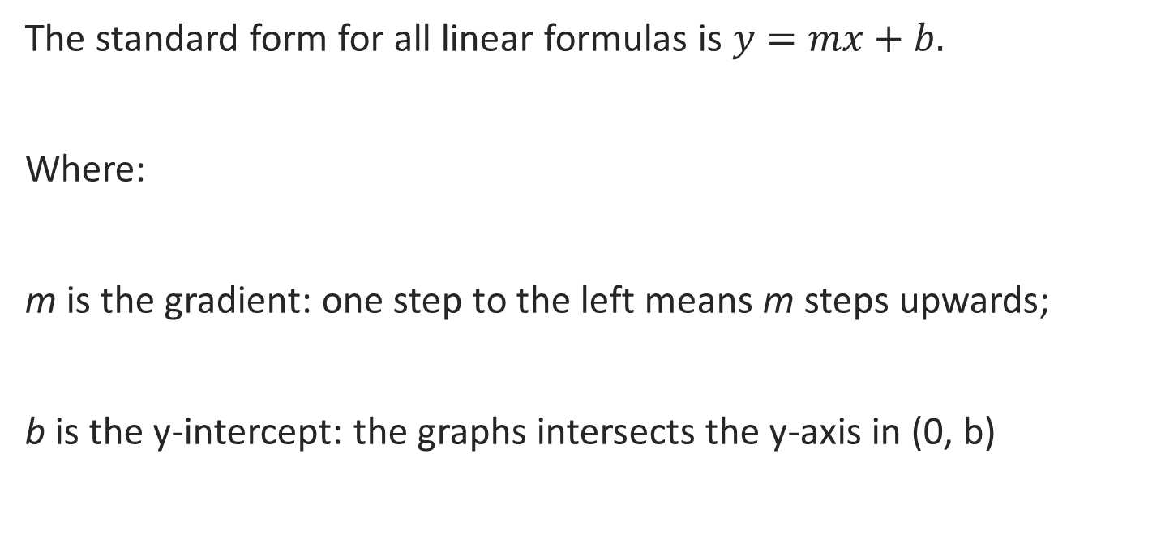
The standard form for all linear formulas is $y=mx+b.$
Where:
m is the gradient: one step to the left means m steps upwards;
b is the y-intercept: the graphs intersects the y-axis in (0, b)

Slide 4
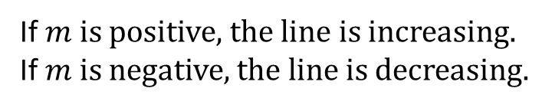




Linear relationships
gradient
$$y$$
$$m=−2$$
$$y=−2x+5$$
7
6
Linear formula: formula that corresponds to a linear relationship.
5
Gradient-intercept form: $y=mx+b.$
4
$y$-intercept
3
$$b=5$$
$m=$ gradient
2
If $m$ is positive, the line is increasing.
If $m$ is negative, the line is decreasing.
1
$$x$$
−4
−3
−2
−1
O
1
2
3
4
5
−1
$b=$ 𝑦-intercept
−2

Slide 5
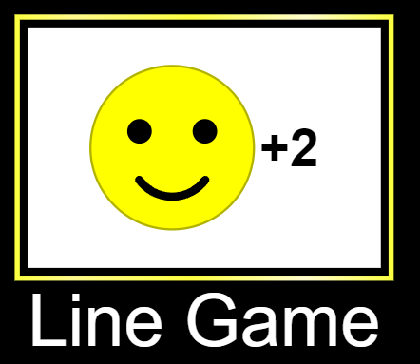
Play the line game (click)!

Slide 6
1. Starting the Request:
"Excuse me, can I ask for help with my math homework?"
"Hey, could you help me understand this math problem?"
2. Specify the Problem:
"I'm having trouble with …... Could you explain it to me?"
"I don't get how to ……. . Can you show me?"
3. Be Specific:
"I'm stuck on question number …… . Could you give me a hint?"
"I don't understand how to find the …….. . Could you go through it step by step?“
4. Request for Clarification:
"Could you clarify what ‘.………….' means?"
"I'm not sure about the steps in ……….. . Can you break it down for me?"
5. Expressing Confusion:
"I'm a bit confused about the concept of ……….. . Can you help me out?"
"I tried solving the problem, but it's still confusing. What am I missing?"
6. Seeking Guidance:
"What's the best way to approach this type of math problem?"
"Do you have any tips for remembering the formulas?"
7. Asking for Examples:
"Could you show me an example of how to solve a similar problem?"
"I learn better with examples. Can you provide one for this concept?"
8. Expressing Appreciation:
"Thanks for taking the time to help me!"
"I really appreciate your assistance. It makes things clearer."

