Slide 1

Innovation Centre for Sustainable Powertrains
Moving towards tomorrow’s power systems
Hydrogen & Transport
in Benelux Region
Notes:
Brief Intro: Short introduction on issues linked to developing sustainable powertrain / HD engines solutions + the anticipated role of TNO’s ICSP initiative

Slide 2
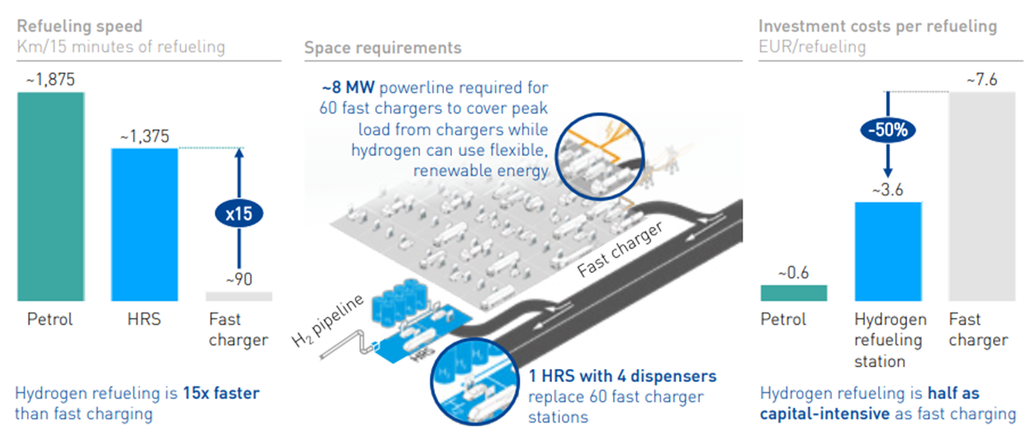
Infra and Cost H₂ as energy carrier versus fossil and electric (incl Safe)

Slide 3
In Summary:
Hydrogen is , next to batteries, an important energy carrier in the energy-transition;
Energy-storage is a game changer in deployment of renewable energy production;
Safety of Hydrogen in transport has been validated extensively;
Hydrogen is applicable in Fuel Cell - EV and Combustion Engines (mainly Heavy Duty and Stationary Power Supply), and speeds up CO₂ reduction;
Hydrogen price still is 3-times higher than conventional fuels, but with the potential to drop in price significantly, this without taking into account the environmental profit.
Hydrogen Fueling Infrastructure: similar to fossil fueling (speed, footprint & cost fueling station), significantly better than electrical charging (speed, footprint, cost charging station).
The transition is being fueled by creating demand & supply simultaneously

Slide 4
Hydrogen demand & supply in de the Benelux propelled by establishing a green (H₂) transport corridor between Rotterdam – Venlo and Antwerp – Venlo (linking 2 major ports with North Rhein Westfalen & the EU-hinterland). Passing a central hydrogen hub in Helmond (fuelling and R&D), near to relevant industries in Flanders and Southern Netherlands and the Automotive Campus. Boosting the hydrogen economy and giving thus the Benelux, regarding hydrogen, a competitive edge in Europe.

