Slide 1
Geotechnical Soil Investigation for the Investigation Areas in IJmuiden Ver Wind Farm Zone, Nederwiek Wind Farm Zone and Hollandse Kust (west) Wind Farm Zone
Information meeting
13 July 2022
13:00 – 14:00 CET
Procurement procedure &
Tender Contents
Liesbeth de Man (RVO)
Michel Vrolijk (RVO)

Slide 2
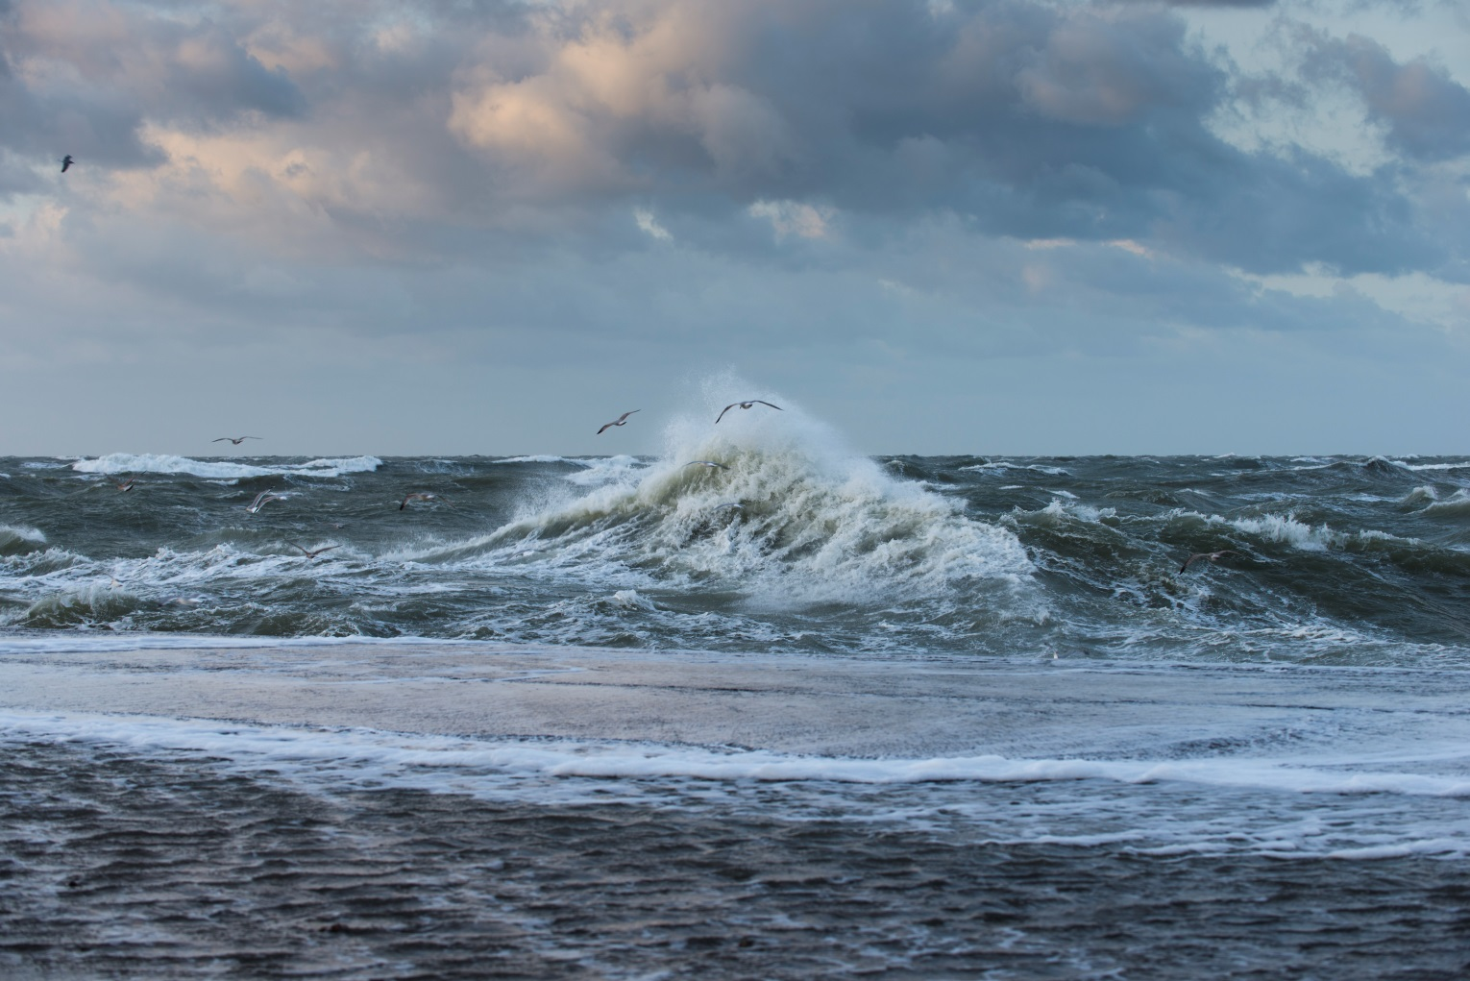
Welcome!

Slide 3
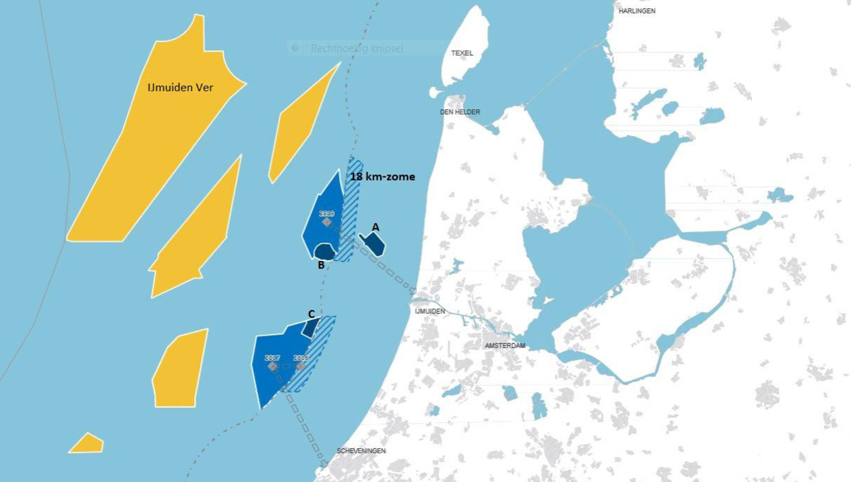
Agenda
Introduction
Procurement
  TenderNed
  Procedure
  Pitfalls
Tender Contents
  General overview IJmuiden Ver
  Minimum requirements
  Preferences
  Bonus mechanism
  Questions?

Slide 4
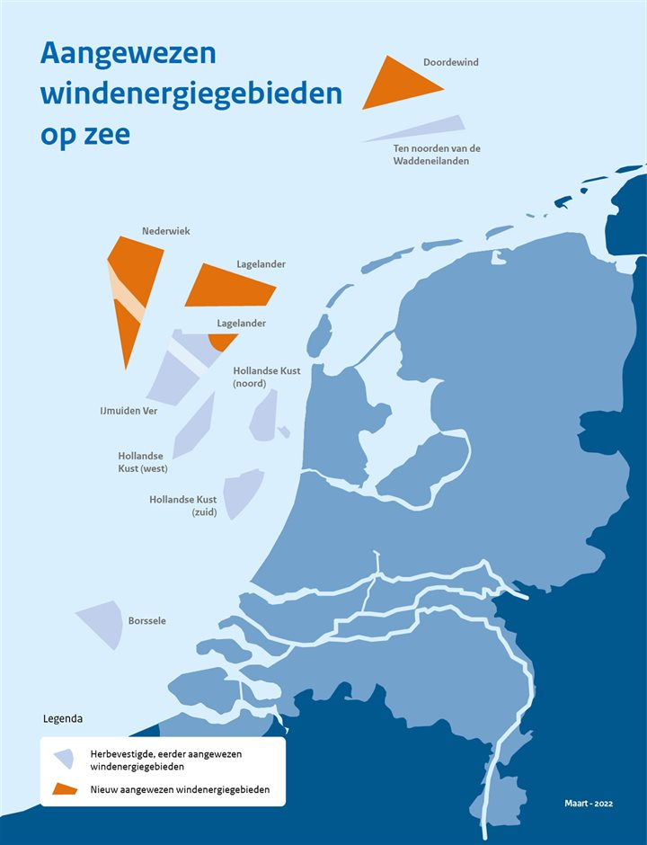
Introduction
RVO initiated this Tender
Reason for this invitation to tender
  Dutch offshore wind roadmap 2030+
  Several Wind Farm Zones
  Dutch Ministry of Economic Affairs asked RVO to collect comprehensive site data
Objective of Geotechnical Survey
  improve the geological and geotechnical understanding of 3 investigation areas, to progress the design and installation requirements for offshore wind farms, including, but not limited to foundations and cables.”
This presentation only highlights some of the Tender Document contents, it does not provide additional information

Slide 5
Introduction (2)
Questions from Tenderers:
  Possible only on this presentation’s contents
  Relevant Q&A from this presentation will be included in Memorandum of Information
  Only answers provided in Memorandum of Information will be legally binding
This presentation will be published on Tenderned

Slide 6
Geotechnical Soil Investigations for three Investigation Areas IJVWFZ, NWWFZ, HKWWFZ
Procurement procedure
Liesbeth de Man (RVO)

Slide 7
TenderNed: Digital Tendering
All tender documents are published on Tenderned
All tender documents need to be submitted via Tenderned
Need any help on Tenderned?
  servicedesk@tenderned.nl
  0800-8363376 on working days from 8.30 a.m. to 6.00 p.m. Calling from abroad: +31 70 379 8899.
  List of certified bureaus for assistance with Tenderned
  As a last resort you can always contact us via IUCEZteam1@rvo.nl attn. Liesbeth de Man

Slide 8
Procedure
25 July 2022, 13.00 hrs CEST:
Deadline to ask questions /raise issues & requests
19 August 2022, 13:00 hrs CEST:
Deadline for submitting tenders
01 September 2022:
Tenderers to provide Letter of Confirmation Vessels, Equipment & personnel
10 October , 2022 Deadline for asking questions about tender result and/or filing an application for a preliminary injunction
Note: uploading documents to Tenderned will take some time!
06 July 2022 | Issuing of publication, start of tendering period.
13 July 2022 13:00 hrs CEST | Digital information meeting in which the assignment and the Tender procedure will be explained. If you would like to attend this meeting, please send an e-mail to IUCEZteam1@rvo.nl, by 12 July 2022 at the latest.
25 July 2022, 13:00 hrs CEST | Closure of round of questions: deadline for the Tenderer to submit questions regarding this Tender Document and all annexes related to this invitation to tender.
08 August 2022 | Issuing of Memorandum of Information
19 August 2022, 13:00 hrs CEST | Deadline for the receipt of Tenders
20 August 2022 – 19 September 2022 | Assessment of Tenders
1 September 2022 | Tenderers to provide Letter of Confirmation of availability of personnel, vessels and equipment (both Lots).
19 September 2022 | Announcement of the award of the Contracts.
10 October 2022 | Deadline for asking questions and/or filing an application for a preliminary injunction in relation to the announcement of the award of the Contract.
10 October 2022 | Deadline for the winning Tenderer to provide the evidence requested by the Contracting Authority
11 October 2022 | Definitive contract award
18 October 2022 | COMMENCEMENT DATE WORK
Notes:
no opportunity to change vessels after the Letter of Confirmation

Slide 9
Tender structure
Tender Document with Annexes 1 – 8
Annex 1 - European Single Procurement Document (ESPD) .
Annex 2a - List of Reference Contracts LOT1.
Annex 2b - List of Reference Contracts LOT2.
Annex 3a - Personnel, Vessels and Equipment LOT1.
Annex 3b - Personnel, Vessels and Equipment LOT2.
Annex 4a - Cycle Time and Price Geotechnical Survey LOT1.
Annex 4b - Cycle Time and Price Geotechnical Survey LOT2.
Annex 5a - Letter of Confirmation LOT1.
Annex 5b - Letter of Confirmation LOT2.
Annex 6 - Section I - Draft Contract.
Annex 6 - Section II - Conditions of Contract.
Annex 6 - Section IIIa - Remuneration LOT1.
Annex 6 - Section IIIb - Remuneration LOT2.
Annex 6 - Section IV - Scope of Work.
Annex 6 - Section V - HSE Requirements.
Annex 6 - Section VI - Quality Requirements & Administrative Instructions.
Annex 6 - Section VI - QA - A1 Template-Contractor-Technical-Query.
Annex 6 - Section VI - QA - A2 Template-Variation-Request form.
Annex 6 - Section VI - QA - A3 Template-Variation-Proposal form.
Annex 6 - Section VI - QA - A4 Template-Document-Review-Form.
Annex 7 - Starting Points and Assumptions
Annex 8 - Complaints Procedure.
Items marked green must be filled out completely and submitted as a part of the Tender (see Tender Document 7.3.15)
Draft letters marked yellow must be completed, signed and submitted by 1 September 2022

Slide 10
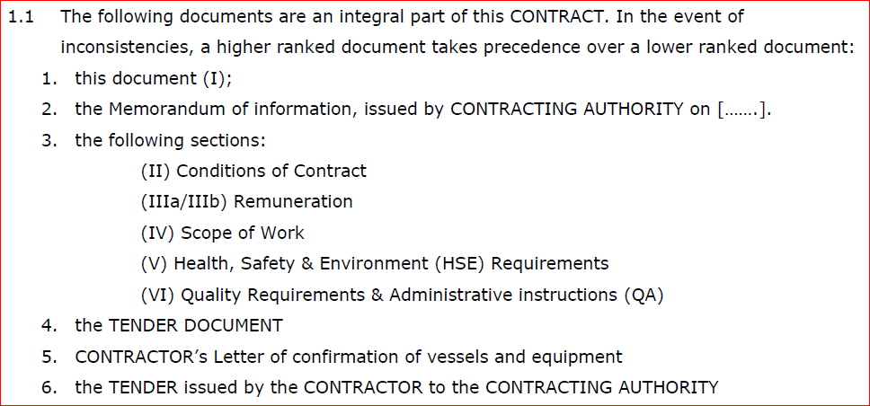
Contract structure
Winning Tenderer will enter into Contract with the following hierarchy:
CONTRACT
(Draft CONTRACT in Annex 6 Section I)

Slide 11

Common Pitfalls
Some things that can lead to exclusion
Lack of a (signed) ESPD
Proposals with provisions
Proposals with own Terms and conditions
Price higher than the admissible maximum
Missing content or documents
Tender uploaded to Tenderned last minute

Slide 12

1. Lack of a (signed) ESPD
The ESPD must be signed either with an original handwritten or a qualified electronic signature by the duly authorised representative(s).
Submitting a Tender in collaboration with other organizations? Please check 7.3.17 of the Tender Document.

Slide 13
2. Tenders with provisions
3. Tenders with own Terms and conditions
This is not permitted in any form (see also 6.1 of the Tender Document)
Any unclarity? Please ask questions.
Applying your own terms and conditions will lead most likely to exclusion
During the Memorandum of Information you can ask questions or propose amendments concerning the LOGIC-terms (RVO version)
After the submission deadline no changes can be implemented

Slide 14

4. Price too high
5. Incomplete Tender
This will immediately lead to exclusion
Check Annex 4 and 5.2.7 of the Tender Document for the price bandwidths.
Check 7.3.15 of the Tender Document
Annex [1] | European Single Procurement Document* | Fill in, legally sign and add to TenderNed
Annex [2a] and/or [2b] | Reference Contracts | Add to TenderNed
Award criteria | A separate response to each of the Tendering Authority’s award criteria. | Add to TenderNed
Annex [3a] and/or [3b] | Qualifications of Team | Add to TenderNed
‘Prices/RatesAnnex [4a] and/or [4b] | Prices/rates and Cycle Times | Add to TenderNed
Other documents | CVs | Add to TenderNed
Annex [5a]/[5b] | Letter of confirmation | Send by TenderNed before 01 September 2022

Slide 15

6. Last minute Tender upload
Tender documents uploaded to Tenderned last minute:
with issues, such as slow uploads
Effect: not meeting submission deadline
Consequence: tender excluded

Slide 16
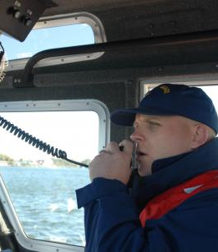
Communication
All communication via Tenderned!
In case of emergency:
IUCEZteam1@rvo.nl,
attn. Liesbeth de Man

Slide 17
Geotechnical Soil Investigations for three Investigation Areas IJVWFZ, NWWFZ, HKWWFZ
Tender Contents
Michel Vrolijk (RVO)

Slide 18
Assignment
2 lots:
Lot 1: 1 seabed CPT and vibrocore campaign (three Investigation Areas) inclusive of basic laboratory testing and reporting; and ecological water and soil sampling at NWWFZ and HKWFZ;
Lot 2: Lot 2 borehole campaign comprising borehole sampling, downhole in-situ testing and extensive basic and advanced laboratory testing and reporting.

Slide 19
Overview Investigation
Areas
Investigation Area Nederwiek Wind Farm Zone
Investigation Area IJmuiden Ver Wind Farm Zone (northern part)
Investigation Area Hollandse Kust (west) Wind Farm Zone
(southern part)
More information: Annex 6 Section IV - Scope of Work

Slide 20
Requirements
Tender Document section
  Section 3: Requirements concerning the requested services and the prices and rates
  Section 4: Requirements concerning the Tenderer
Tender will be excluded when Tenderer cannot comply with these requirements
In case you have questions about the Requirements please be sure to send in the questions before the deadline of July 25, 13:00 CEST.

Slide 21
Award Criteria
Tender Document section 5
Paragraph number | Subject | Maximum number of points to be obtained
§5.2.1 | Project documentation | 20
 | Project Execution Plan | 10
 | Project HSE management plan | 5
 | Project Quality Plan | 5
§5.2.2 | Qualifications personnel | 14
 | Level and type of education | 4
 | Experience | 10
§5.2.3 | Vessel(s), equipment | 30
 | Vessel(s) | 15
 | Survey Equipment | 15
§5.2.4 | Cycle times for the WORK | 10
§5.2.5 | Sustainable campaign execution | 3
§5.2.6 | Compliance with BRO | 3
§5.2.7 | Prices/rates | 20
 | Total | 100

Slide 22

Planning is important
Some essential topics in this project:
  Co-operation with Integrated Ground Model Contractor & Client team
  Deliverables delivered on time
Please substantiate how Tenderer will achieve planning, notably lab testing
Planning and pricing captured in Annex(s) 4
Mala on late delivery of deliverables on key dates (ref. Annex 4, tab Key Dates)
Also bonus mechanism to provide deliverables on time (next slide)

Slide 23
Bonus mechanism
Bonus applicable when meeting Contractor proposed dates: dates that Tenderer puts in Annex 4
Applicable to a number of key dates, not all
Total bonus: % of Contract Price
Further reference: Annex 6 IV Remuneration, section 5

Slide 24

Questions?

Slide 25
Thank you for participating!

