Slide 1



Artificial Intelligence
Waterschapsbedrijf Limburg
Pre-Commercial Procurement
mr. Stephan Corvers – Corvers Procurement Services B.V.
ir. Katinka van Aert – Waterschapsbedrijf Limburg
drs. ing. Léon Verhaegen – Waterschapsbedrijf Limburg

Slide 2
Program
Opening – PCP and TRL
Introduction WBL
Process status
EU Survey questions
PCP process & relation with EAFIP
IPR & FRAND
Q&A
Time schedule
Closure

Slide 3
1. Opening - PCP Procedure
PCP is a public procurement of Research and Development (R&D) services characterized by:
Competitive development in phases
Risk-benefit sharing under market conditions
A clear separation between the procurement of the R&D from the deployment of commercial volumes of end-products

Slide 4
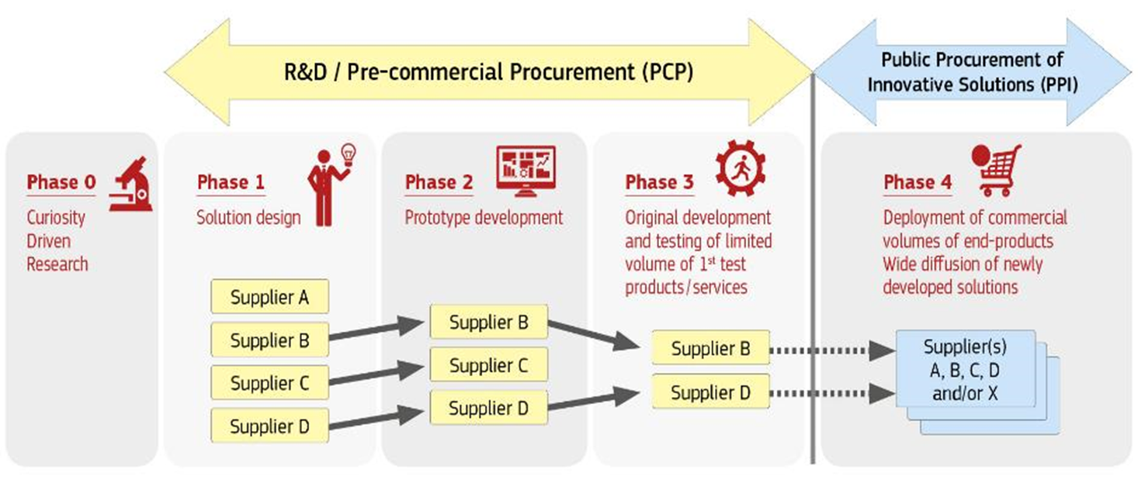
1. Opening - PCP Procedure

Slide 5
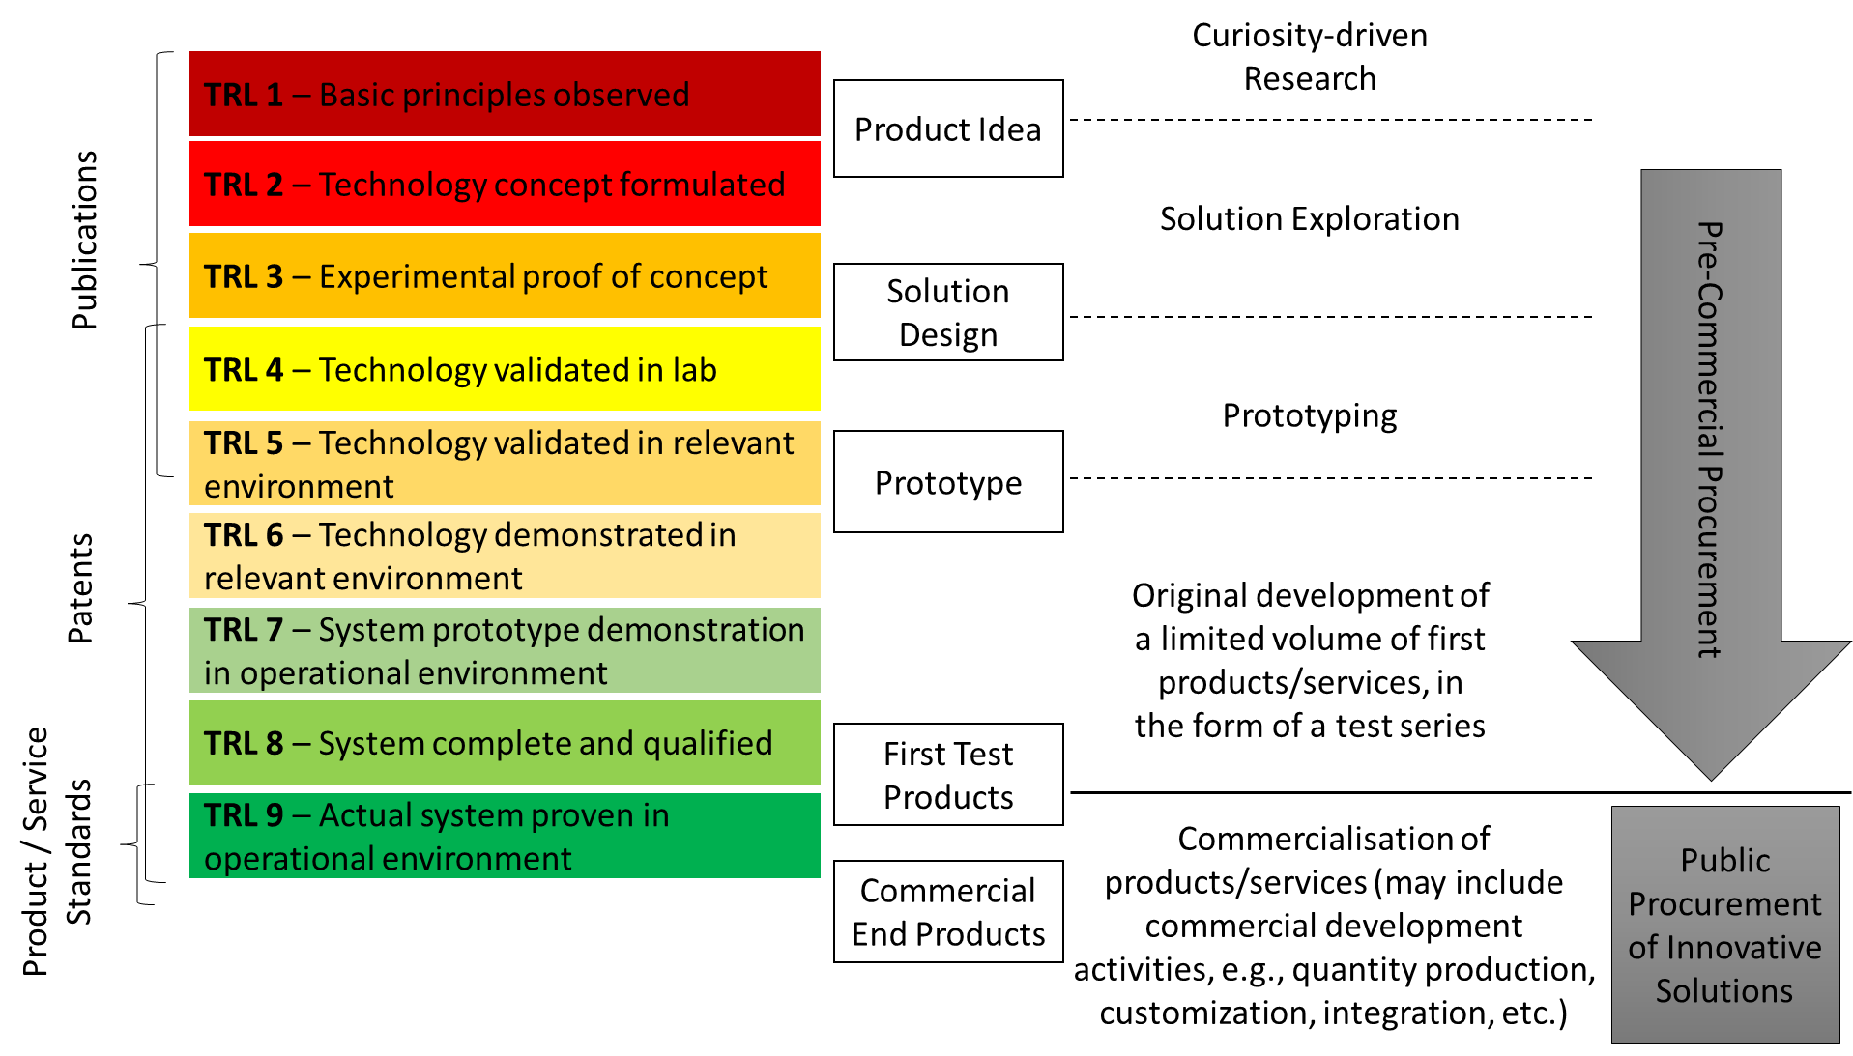
1. Opening – Innovation - TRL levels

Slide 6
2. Introduction WBL
Video

Slide 7
3. Process Status – EU Tender

Slide 8
3. Process status - PCP

Slide 9
3. Process Status – Phase 1 PCP - Design Lot3

Slide 10
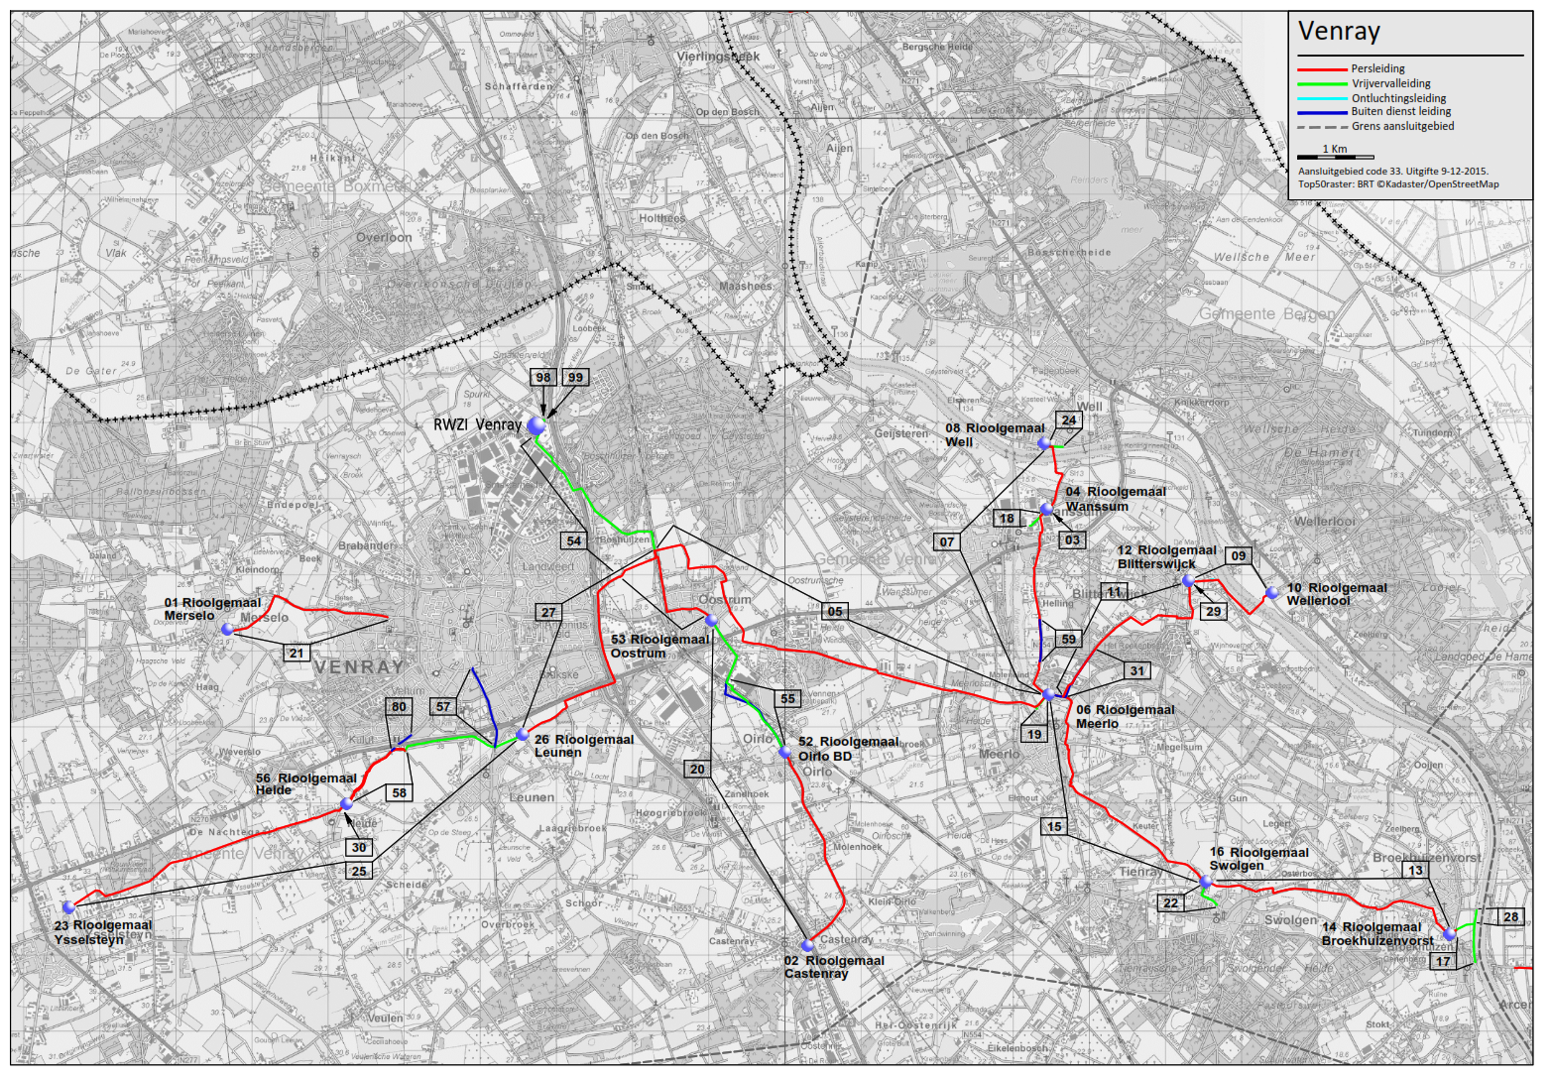
3. Process Status – Phase 1 PCP –
Design Transport System Prototype / Future

Slide 11
3. Process Status – Phase 2 PCP Prototype

Slide 12
3. Process Status – Phase 2 PCP Prototype

Slide 13
3. Process Status – EU Tender Big Data

Slide 14
3. Process Status – Phase 3 PCP WBL Full

Slide 15
3. Process Status – Future PCP

Slide 16
4. EU Survey questions
Underlying rationale for the PCP (procurement of R&D services)
Is the challenge, its approach and its objectives clear
is the challenge feasible (outcome TRL=8)
Is the challenge doable (technical, financial, timing)
Is the challenge addressing your needs (business wise, relationship wise)
If not, please ask additional questions

Slide 17






5. PCP process & relation with EAFIP
A total of 5 projects have been selected under the scope of the EAFIP (2019-2020) initiative of the European Commission:
  WBL: Artificial Intelligence - PCP (NL)
  Gobierno de Canarias: Big Data for Personalised Medicine - PCP (ES)
  MVB-STIB: Muntstroom Living Lab - PCP (BE)
  Austrian Patent Office: Chatbot Albert - PPI (AT)
  Smart Dublin/Dublin City: Smart Tech, saving lives - IoT Network to monitor and report on Life Rings - PPI (IE)

Slide 18
5. European Assistance for Innovation Procurement (eafip) (2015-2018)

Slide 19
5. Eafip 2015-2018
European Commission DG CONNECT
Knowledge transfer to contracting authorities throughout Europe
  Workshops & conferences
  Toolkit
  Local assistance (12 PCPs and PPIs)
Network-approach
Demand driven policy – no support to companies
www.eafip.eu

Slide 20
5. Eafip 2019-2020
the new EAFIP call for assistance open
till 13th of December 2019
Please find here the link: https://ec.europa.eu/eusurvey/runner/EAFIP2019
to the EAFIP call for assistance to be disseminated.

Slide 21
5. EAFIP & WBL
Enhanced & integrated approach:
  the WBL program is combining and integrating standard procurement & PCP
  First time in Europe (forerunner in innovation procurement)
Bridging the R&D-phase and the deployment-phase
High interest from European perspective
European outreach both from academic and practical perspective (understanding legal & business challenges, both from the demand and supply side)
Lessons learned through EAFIP-initiative & academia

Slide 22
6. IPR & FRAND
What are market conditions ? (2007 Communication)
  IPR remains vested in technology vendors
  Contracting authority is granted a free license to use
  Draw-back clause in case of non-successful commercialization of IPR
  PCP technology vendors are being offered to deploy their solutions through contractors of lot 1, 2 and/or 3 using FRAND conditions
  What is FRAND ?

Slide 23
What is FRAND?
Fair, Reasonable and Non-Discriminatory Agreements
WBL will receive from the AI-Big Data PCP suppliers a royalty free non-exclusive license to use the developed technology for indefinite time.
FRAND agreements will be concluded between two technology vendors in phase 3 of the PCP and the three different suppliers of [Lots 1, 2 and 3 – if applicable -].
FRAND licensing aims to compensate the innovative companies through patent royalties so they can re-invest in next generation technologies, while allowing fair access to their technologies based on trust.
The FRAND requirement facilitates wide use of standard essential patents (SEPs).

Slide 24
7. Q&A
ANNEX 1-8 are for your information – NO QUESTIONS

Slide 25
8. Time schedule
12 September 2019 | Publication of pre-announcement and making available market consultation documents & list of questions (through the EU Survey).
20 September 2019 | Possible publication of updated version of the EUSurvey.
27 September 2019 | Registration for the meeting in Roermond
4 October 2019 | Physical meeting for explanation and possible questions. Date: 4th of October 2019 Time: 14:00 – 16:00 CET Location: Congrescentrum Het Forum, Elmpterweg 50, 6042 KL Roermond, The Netherlands Info: http://forumroermond.nl/
12 October 2019, not later than 17:00 CET | Deadline to receive answers to the questions in the EU Survey
31 October 2019 | Publication of market consultation report.
1st November 2019 | Closure of market consultation.
End 2019 | Launch PCP procurement

Slide 26
9. Closure
Additional remarks & Questions ?

