Slide 1
Vision and Design
14th May 2018

Slide 2
Background
Our new Terminal building must be up and running in 2023. The design of the terminal is
spacious and flooded with daylight using a unique roof structure that embraces the Dutch sky.
The design maintains and enhances the one terminal concept and DNA of Schiphol in its
architectural and spatial form where open views, space and light have been given priority . The
terminal building is approx. 100,000 square meters in size, contains a Baggage Handling System
and will be designed to accommodate 14 million passengers per year
The design team, is KL AIR, being a collaboration (Joint Venture) between KAAN Architects, ABT,
Ineco and Estudio Lamela. The following pictures illustrate the new Terminal’s design.

Slide 3
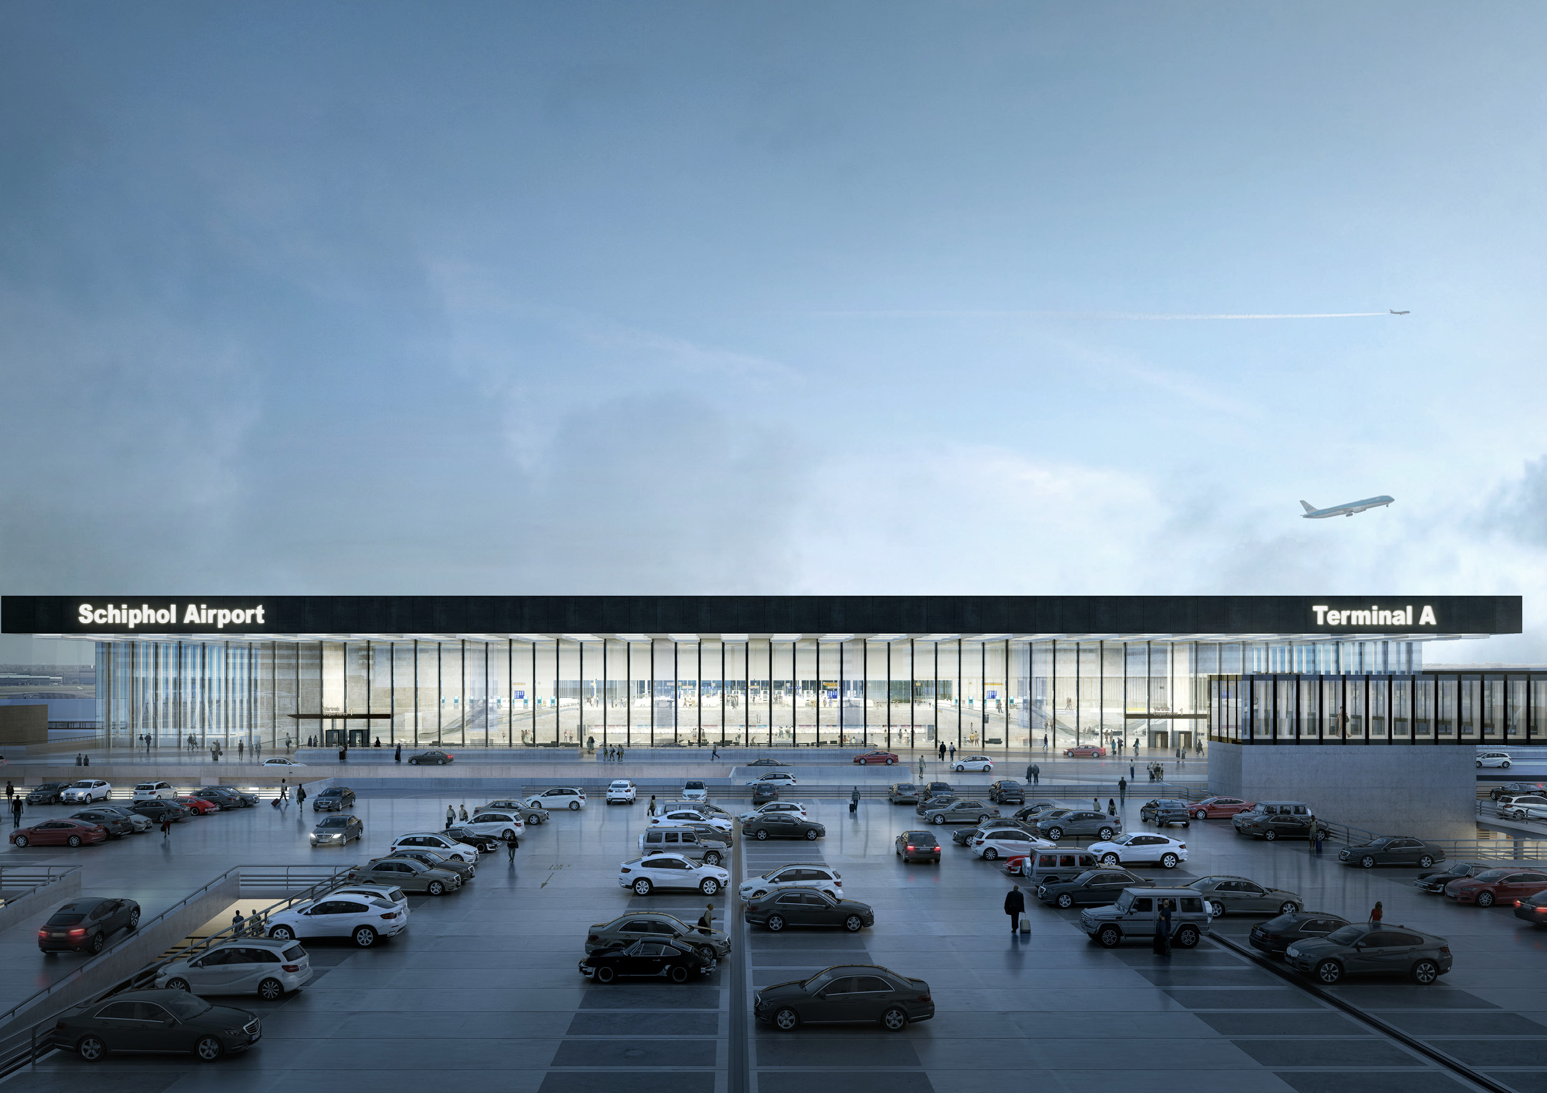

Slide 4
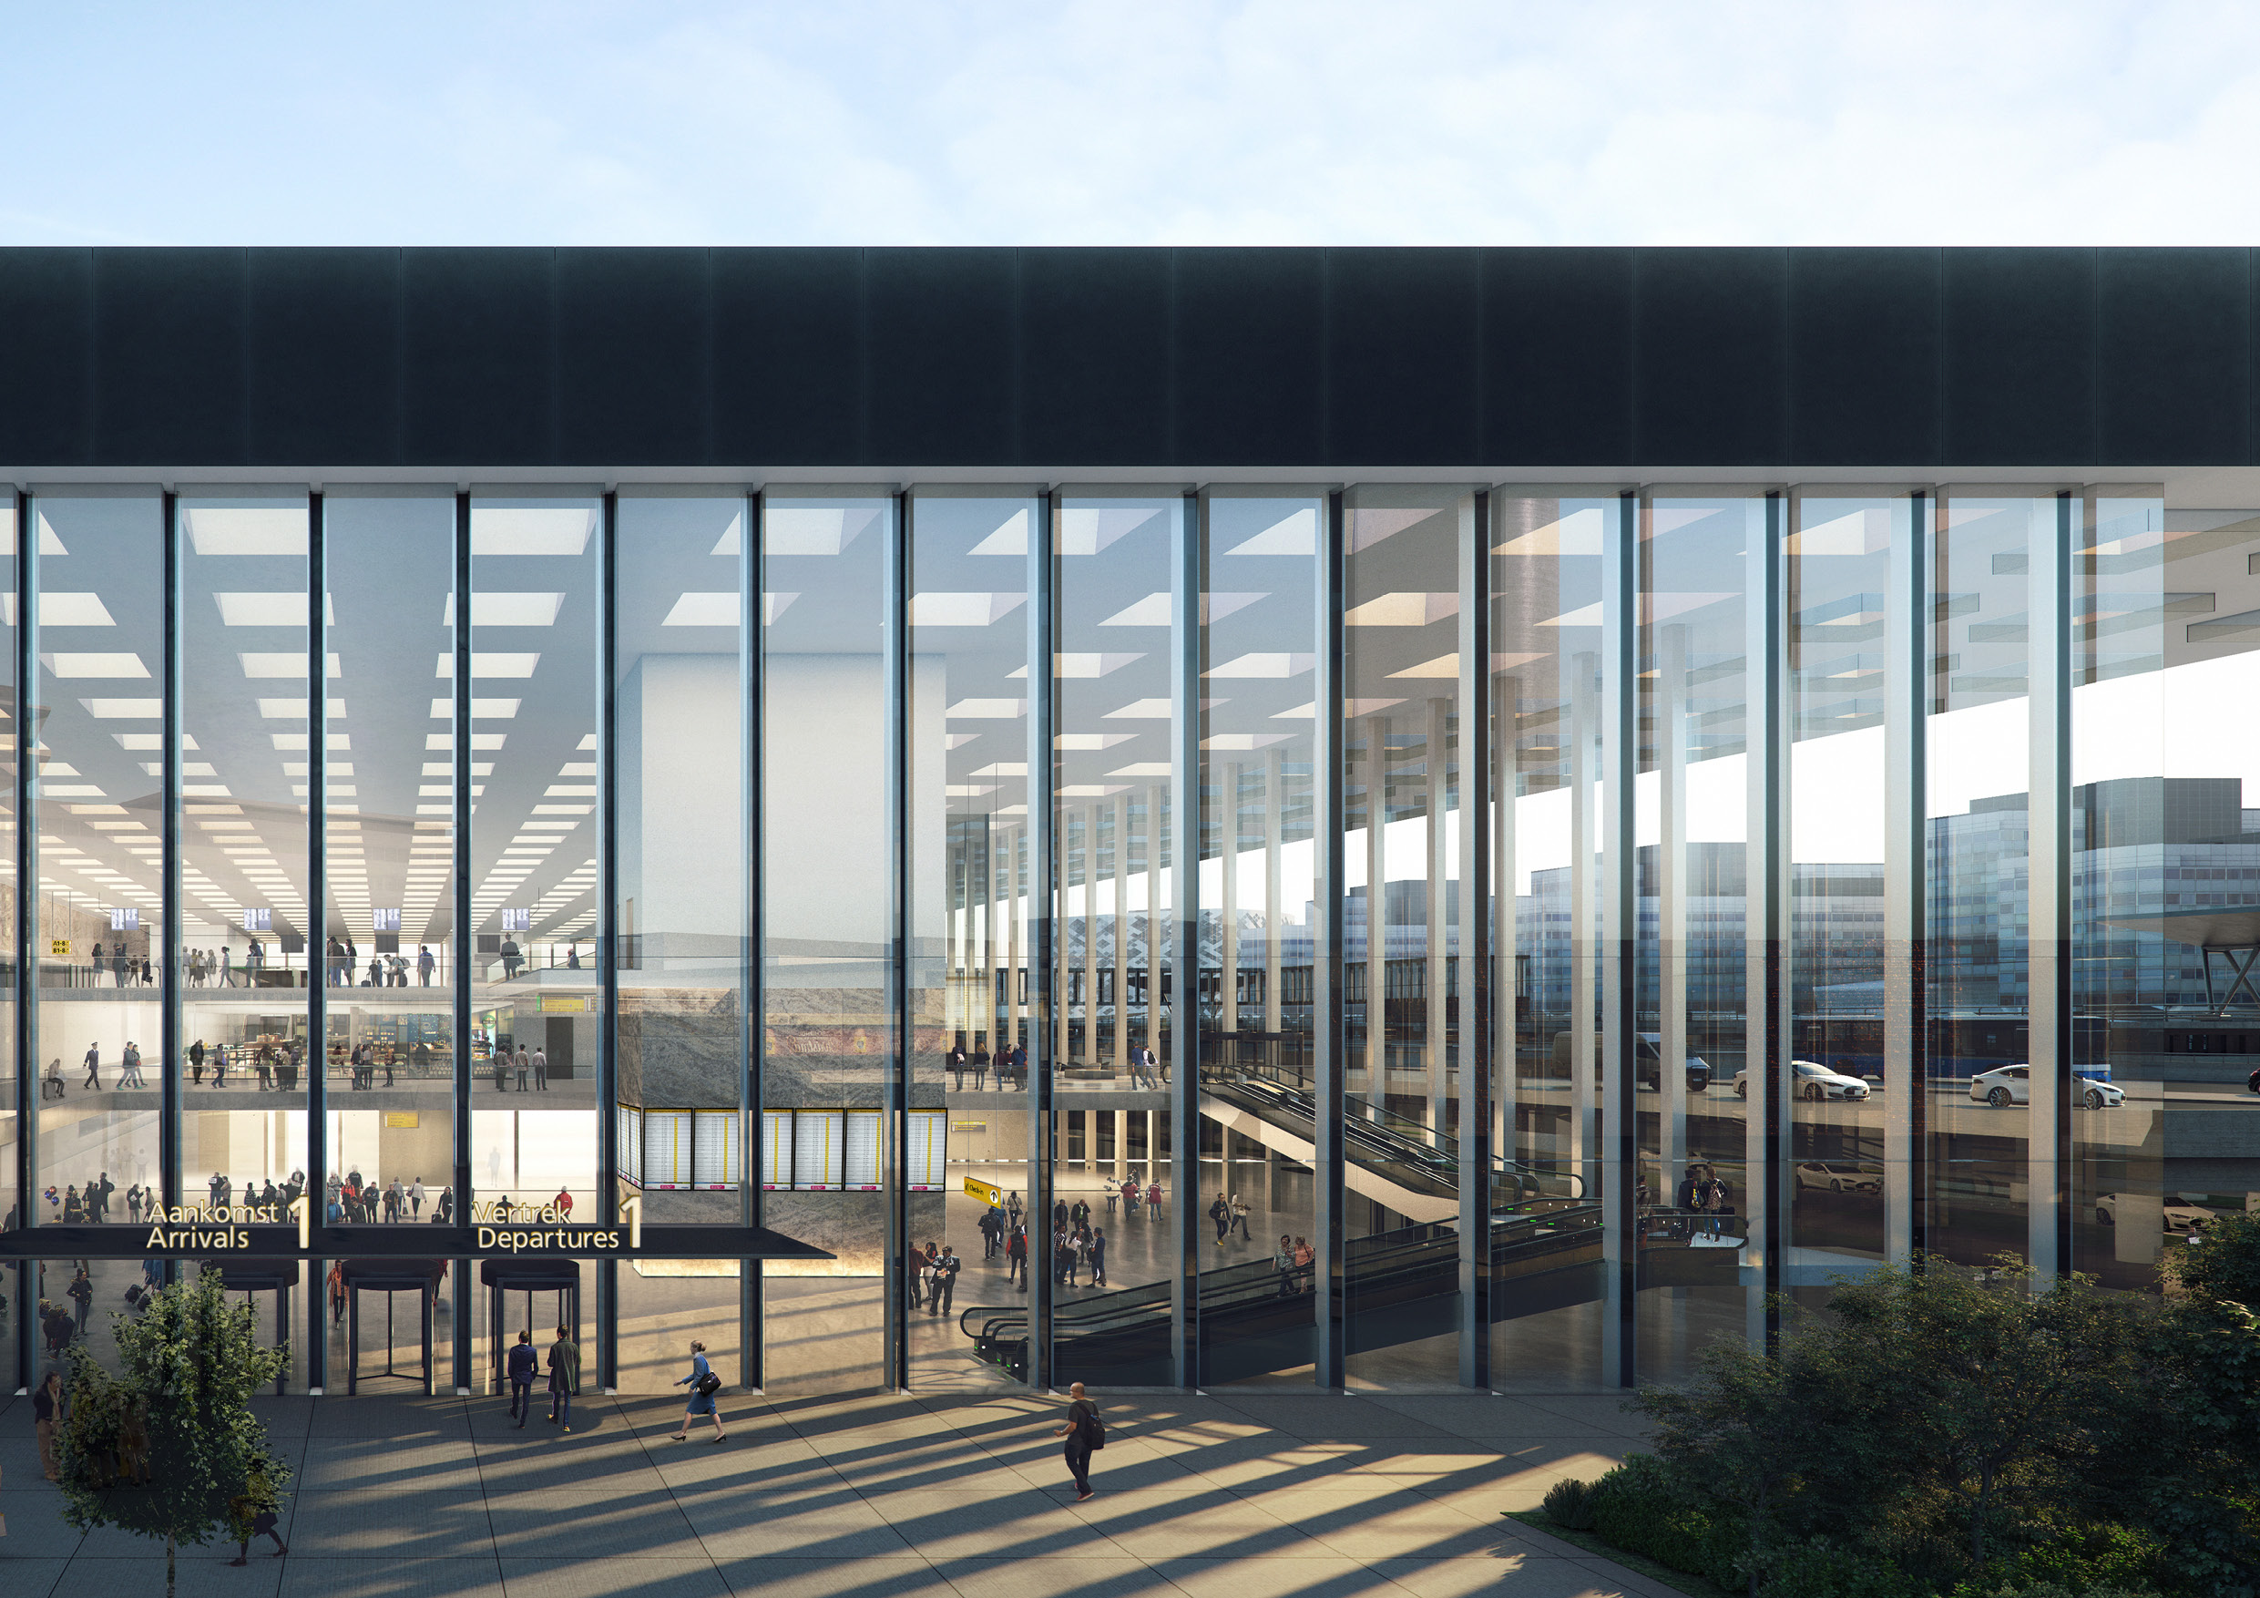

Slide 5
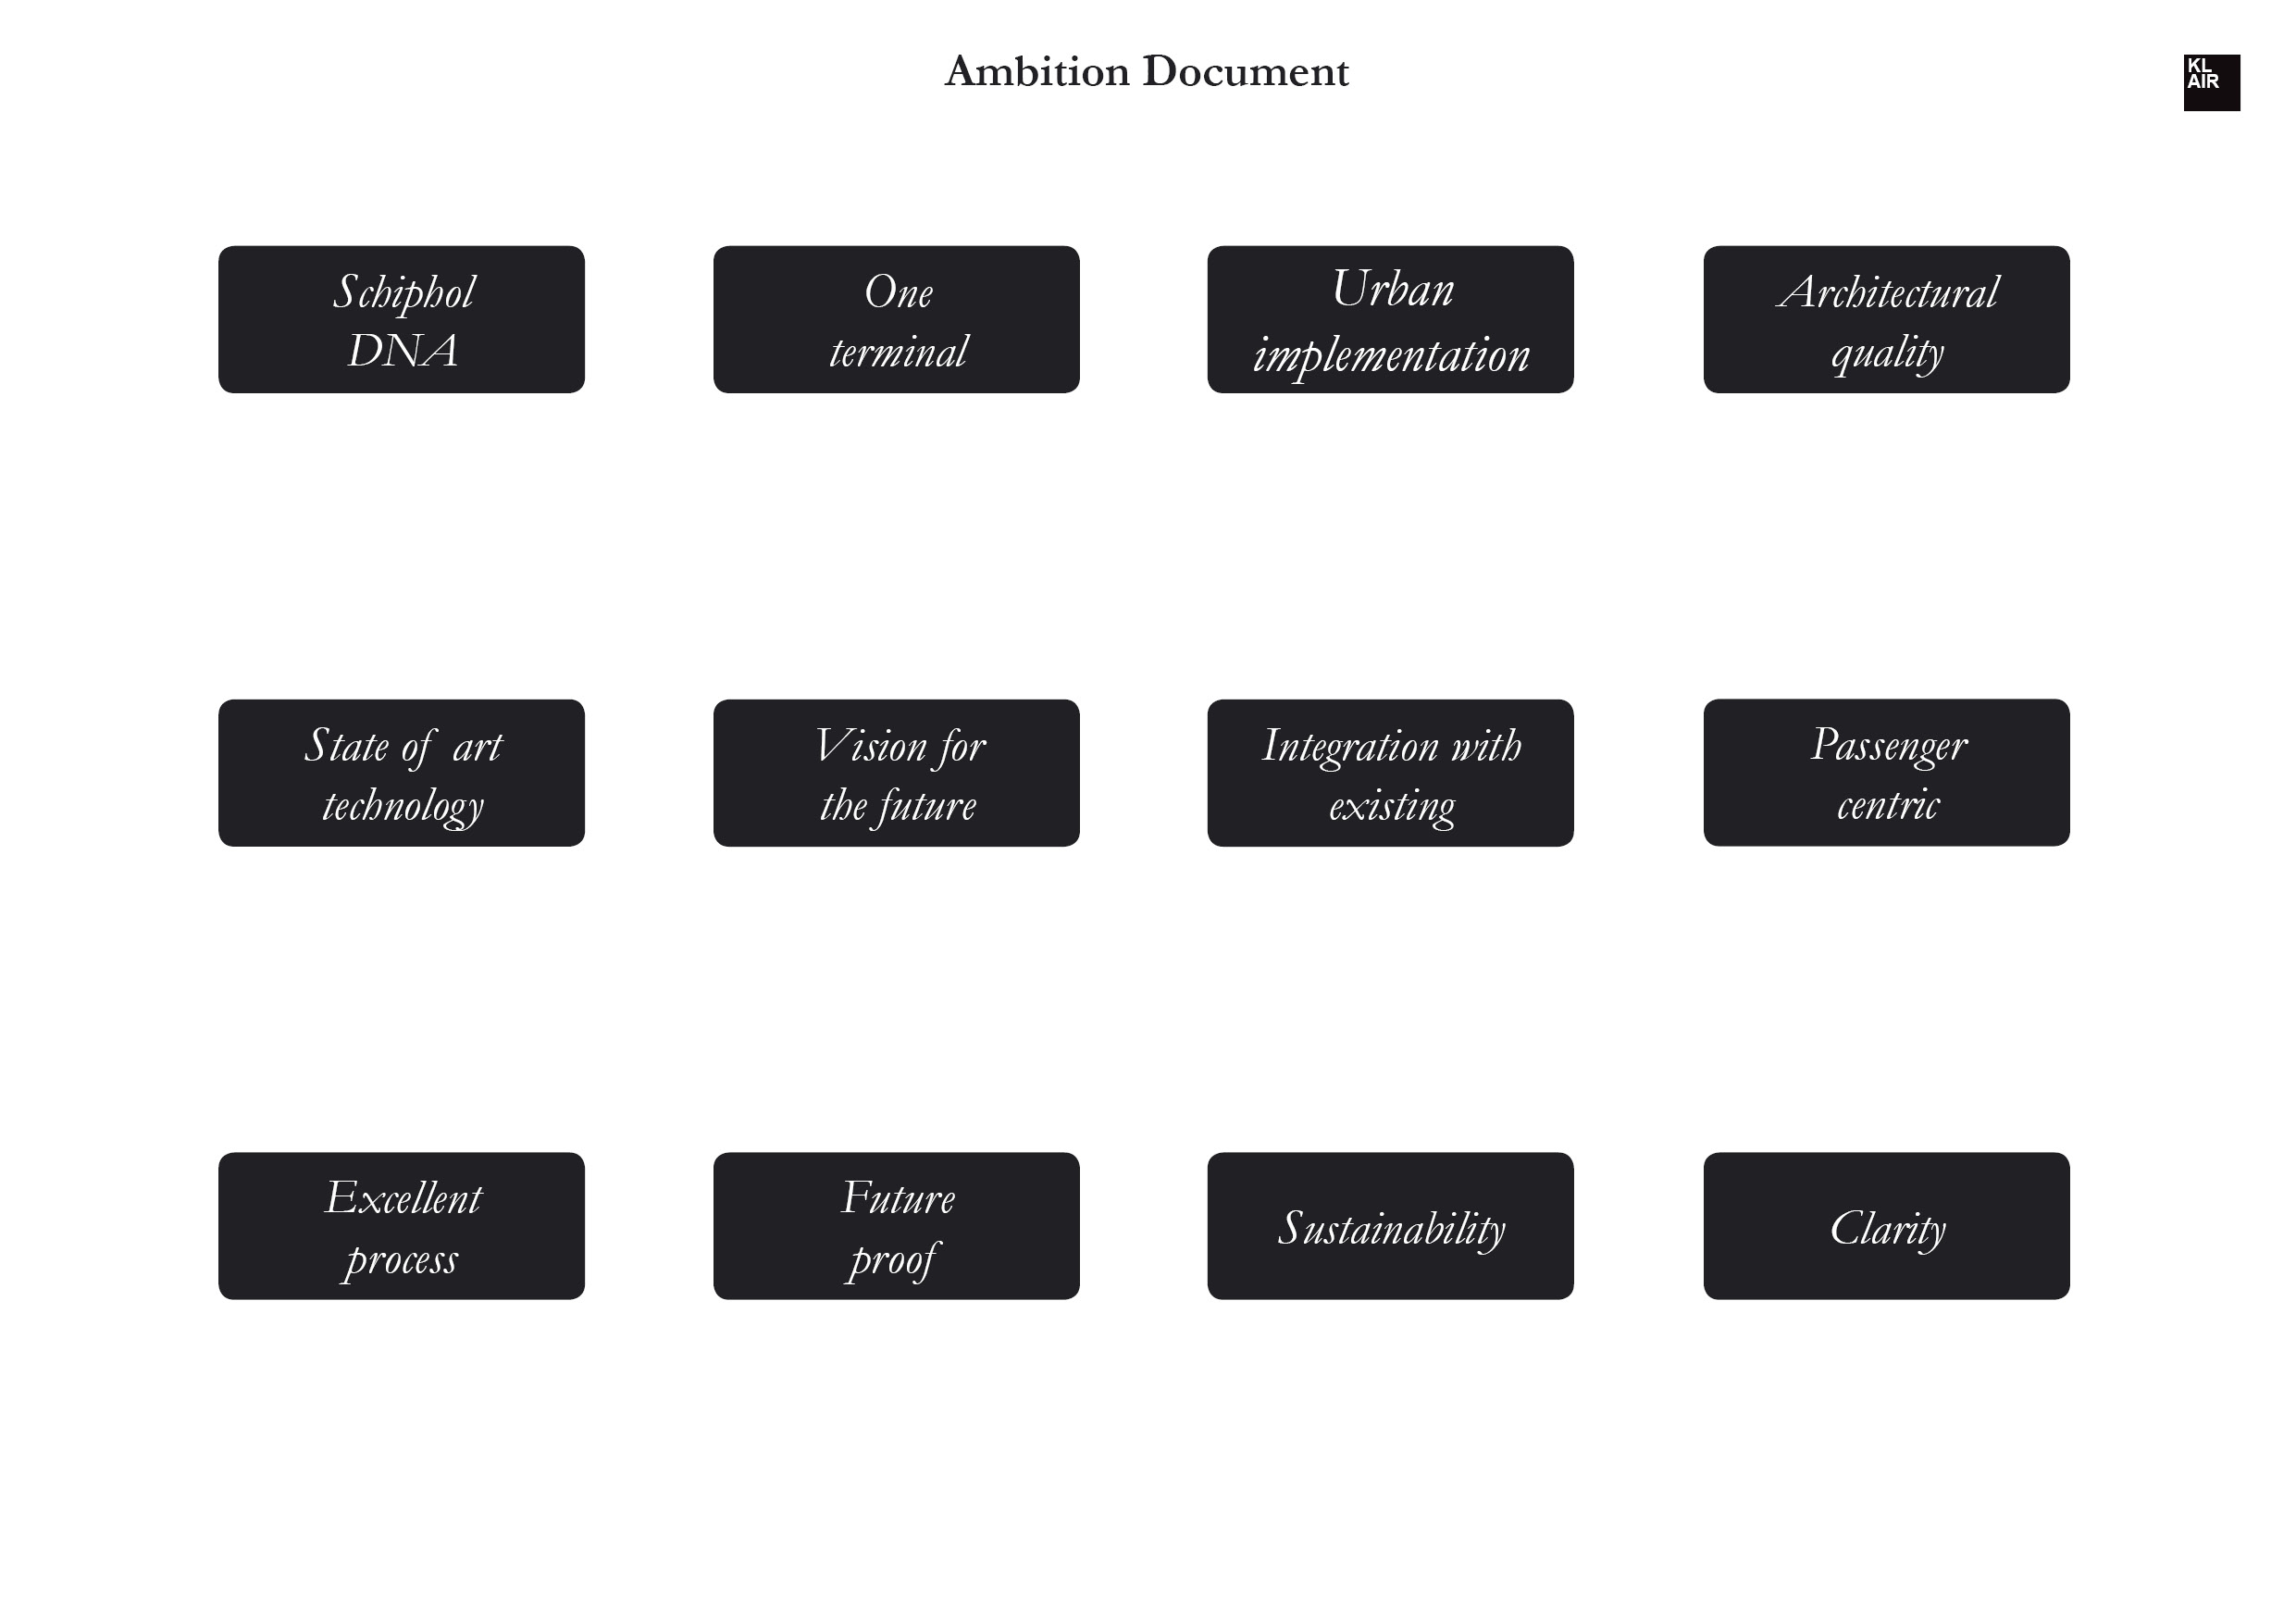

Slide 6
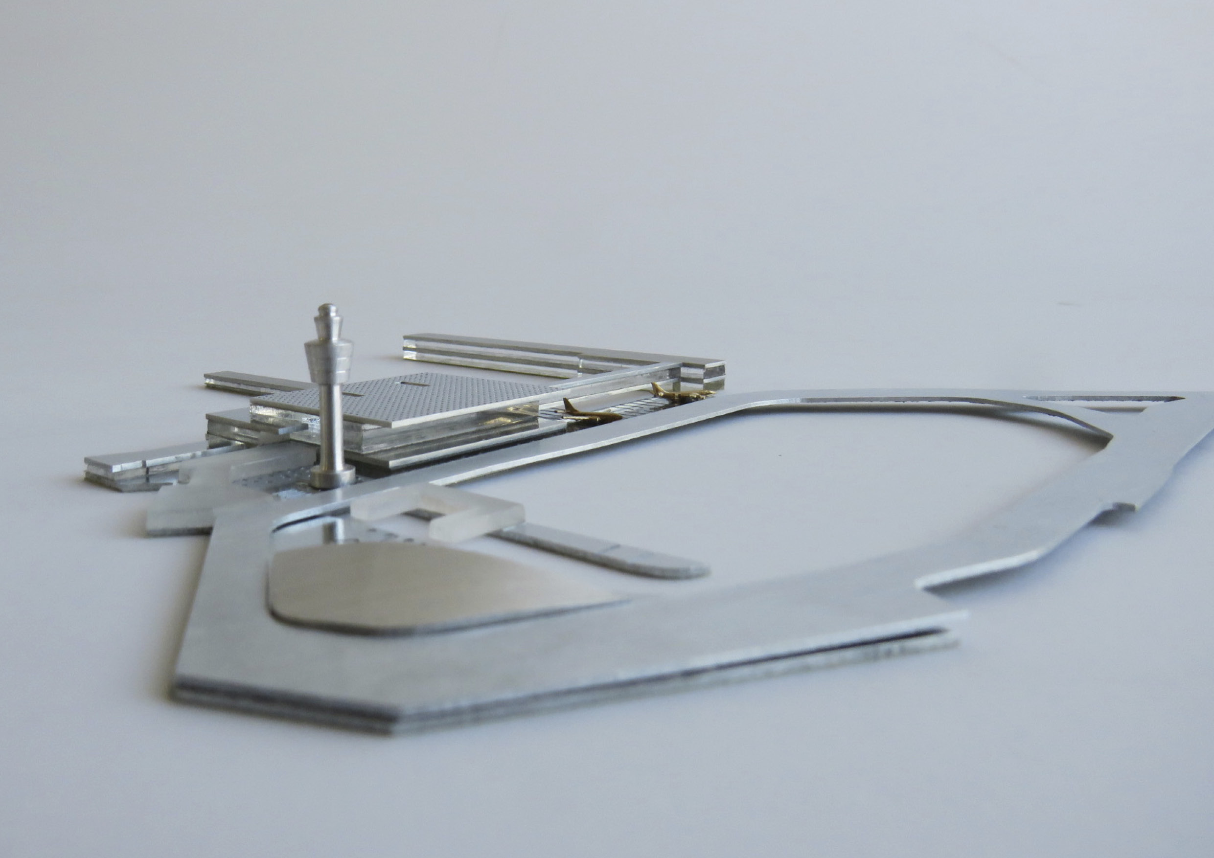

Slide 7
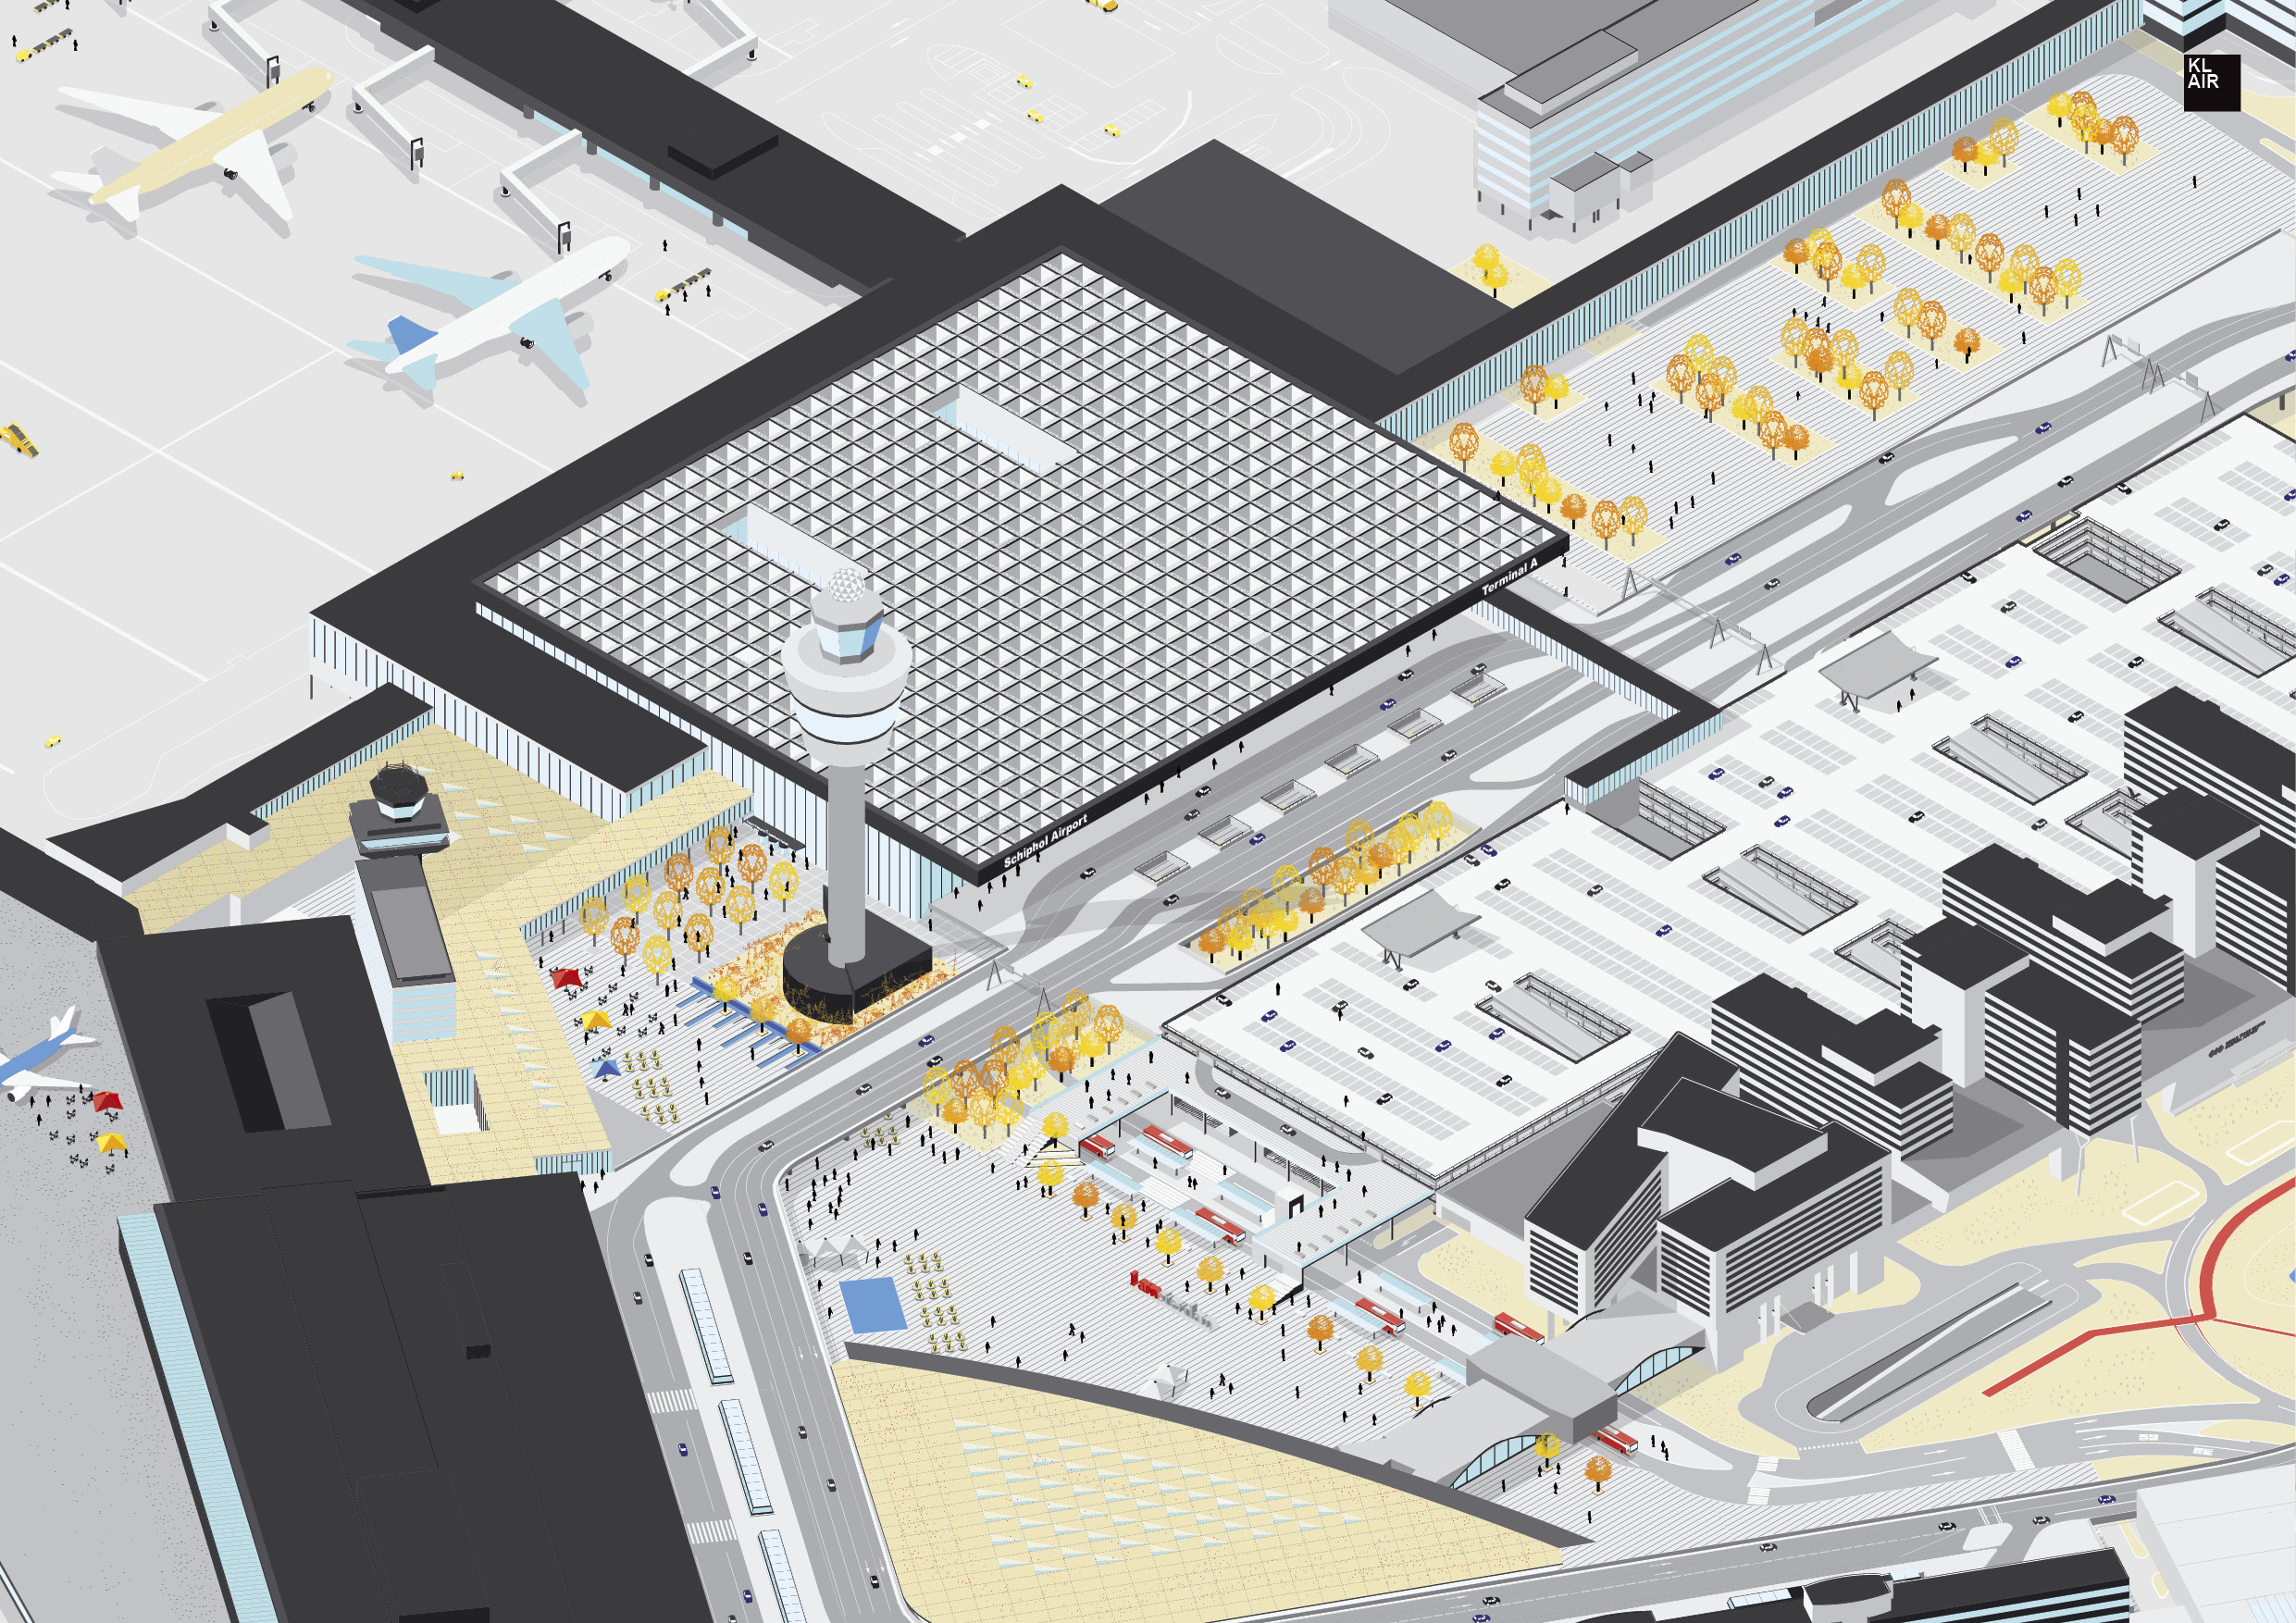

Slide 8
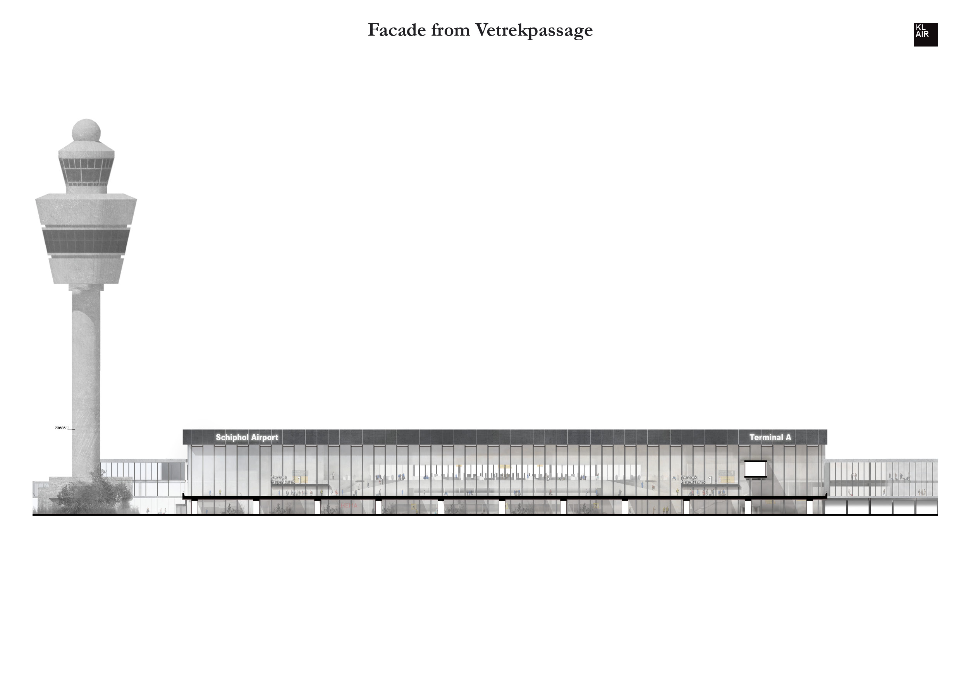
Façade from Vertrekpassage

Slide 9
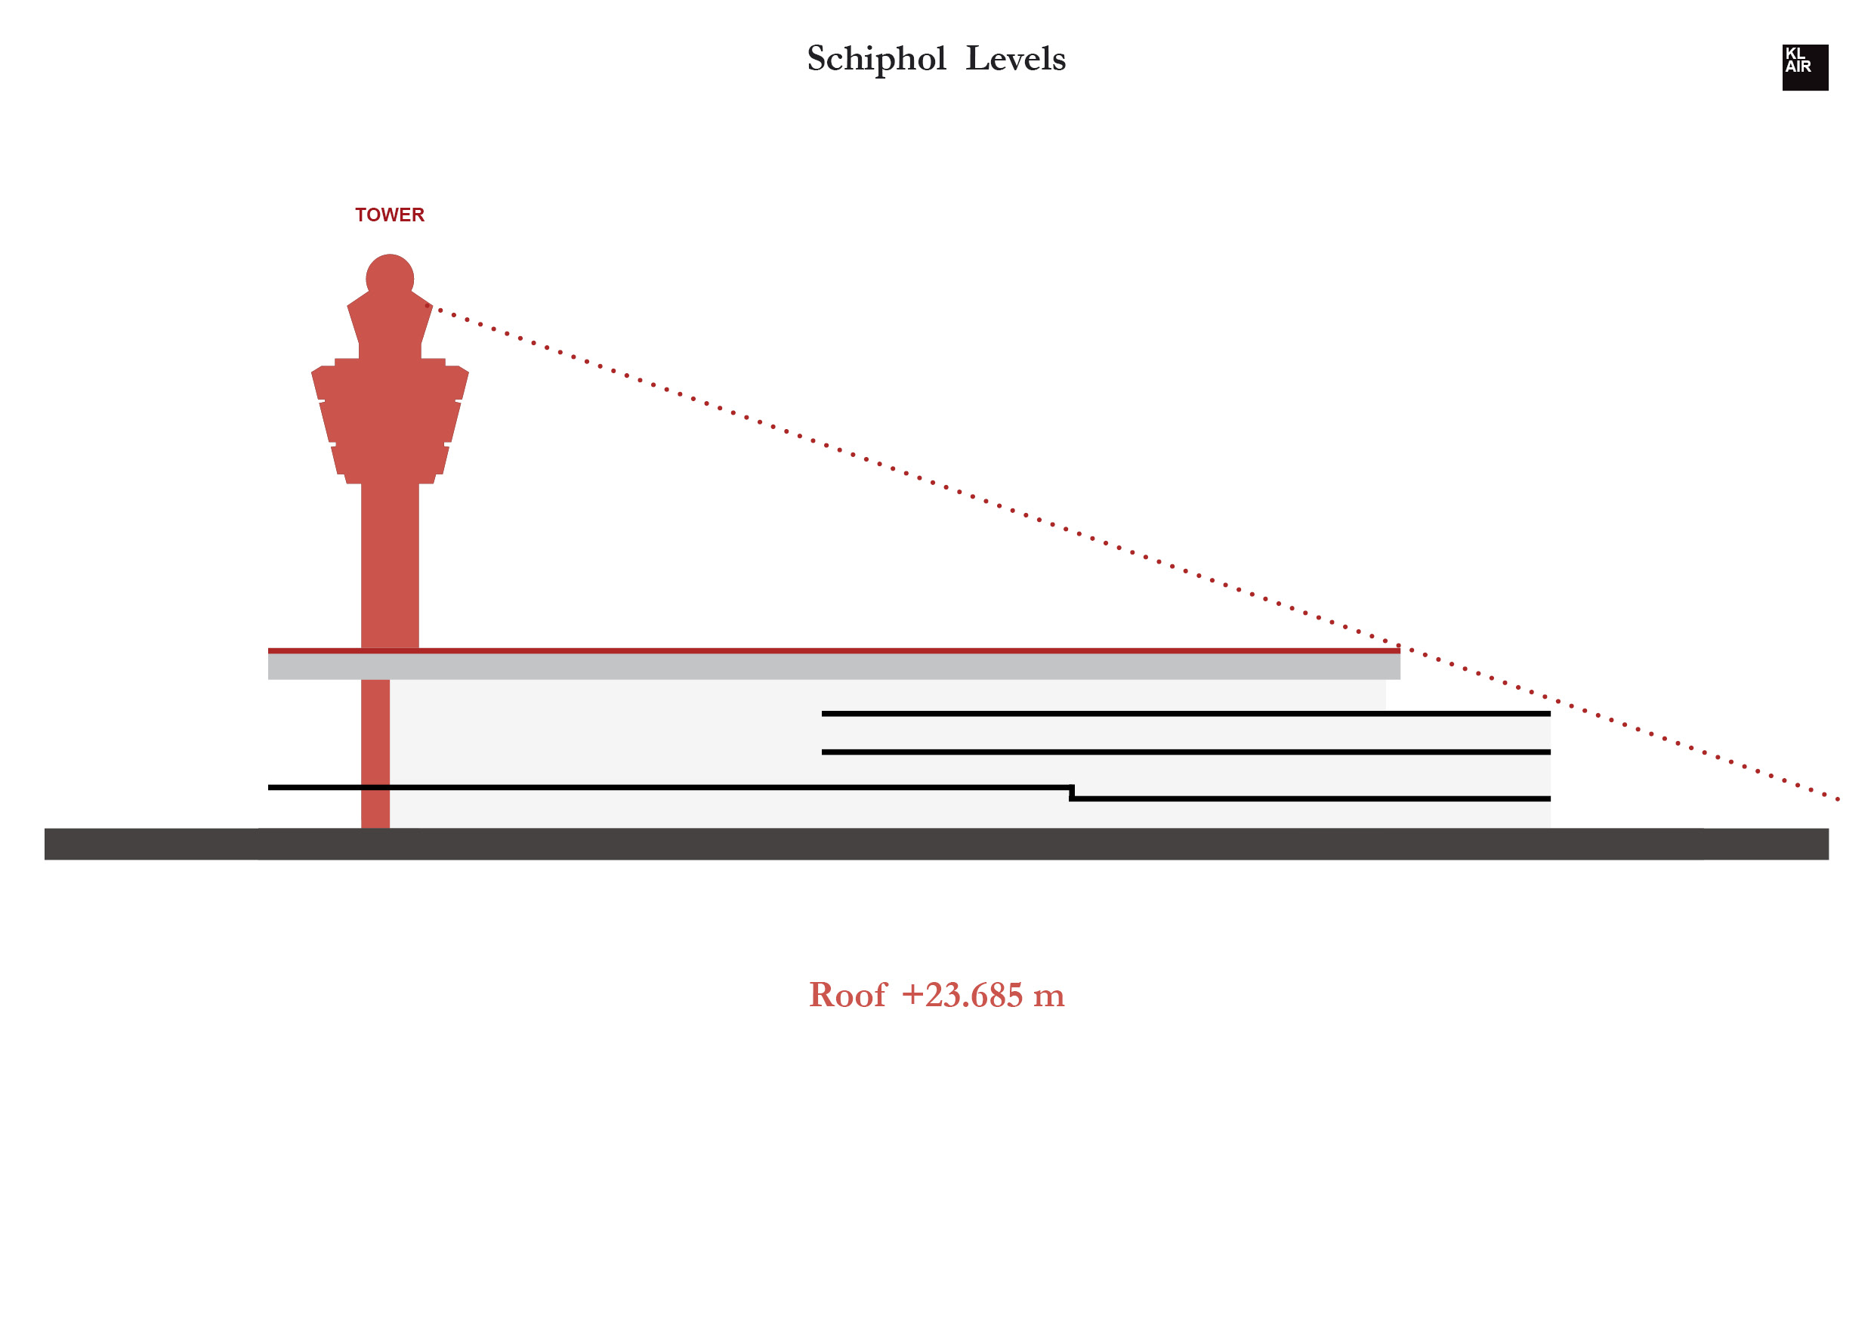

Slide 10
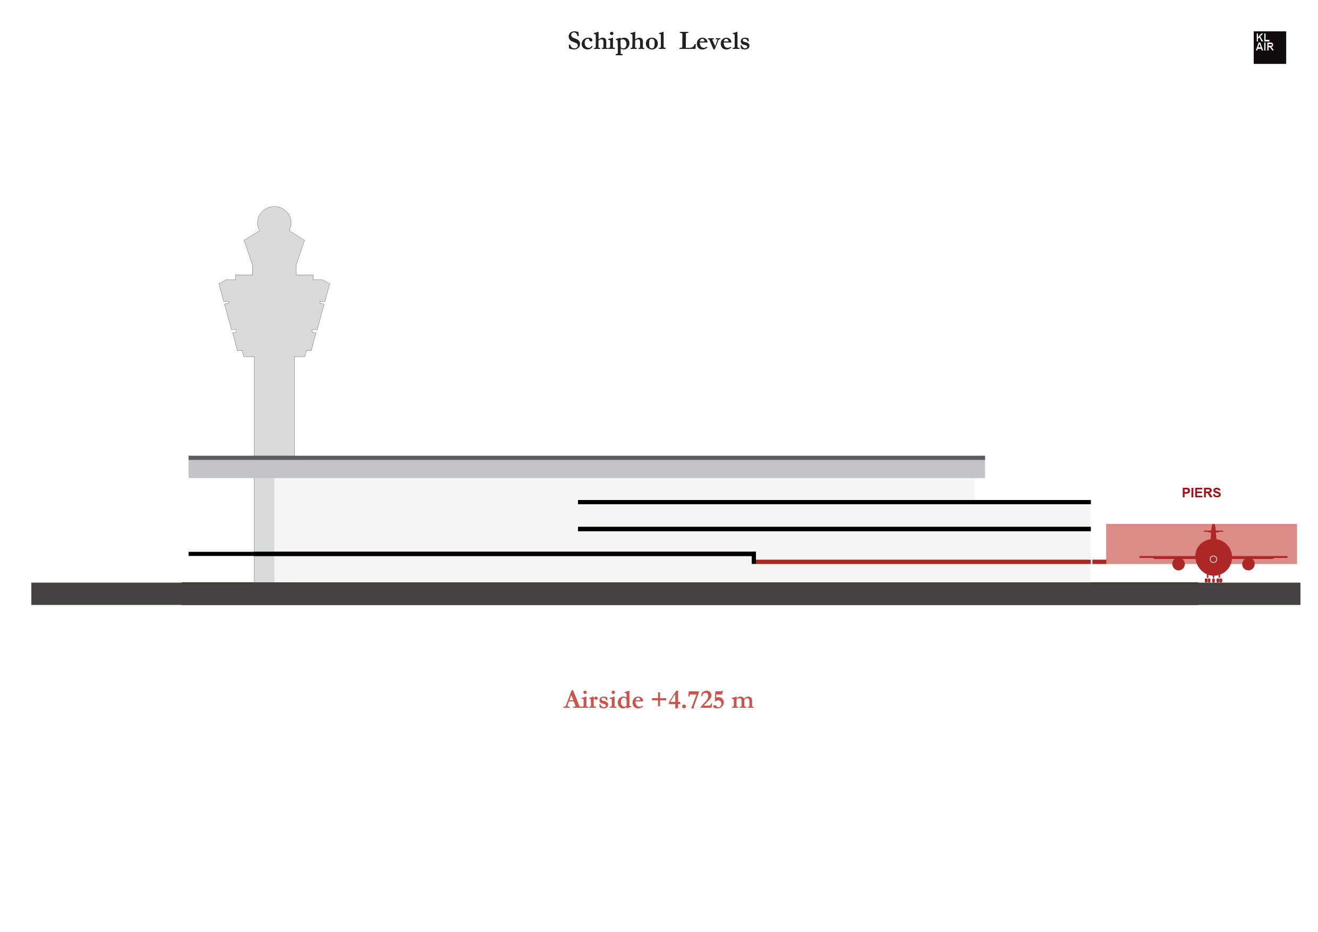

Slide 11
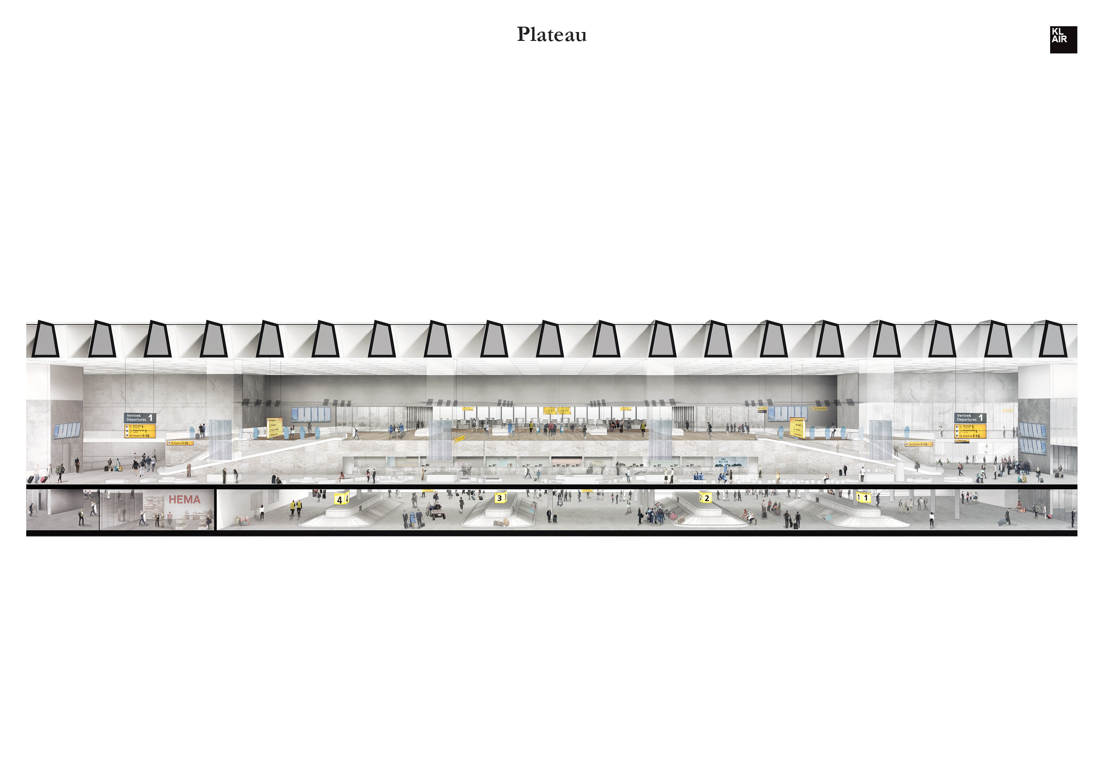

Slide 12
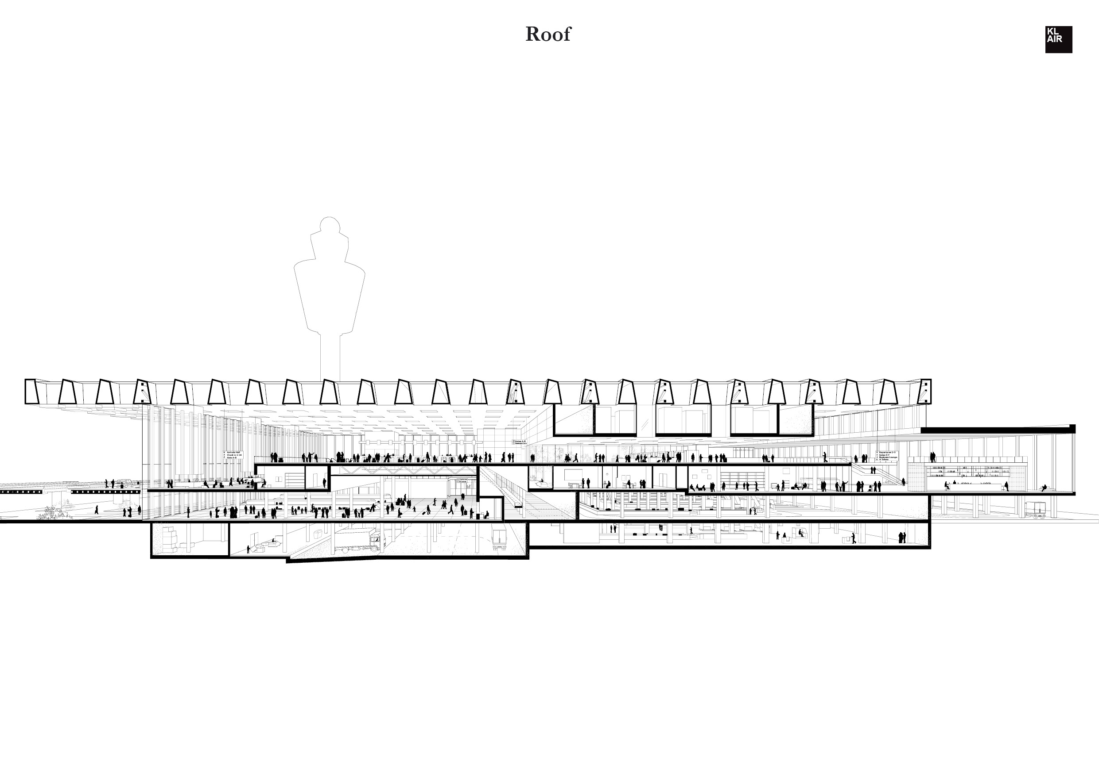

Slide 13
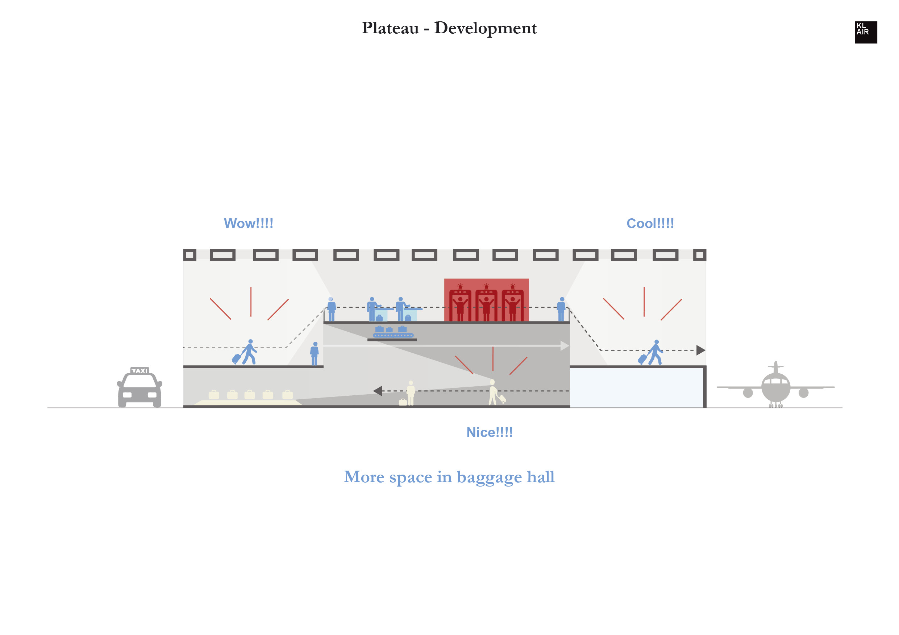

Slide 14
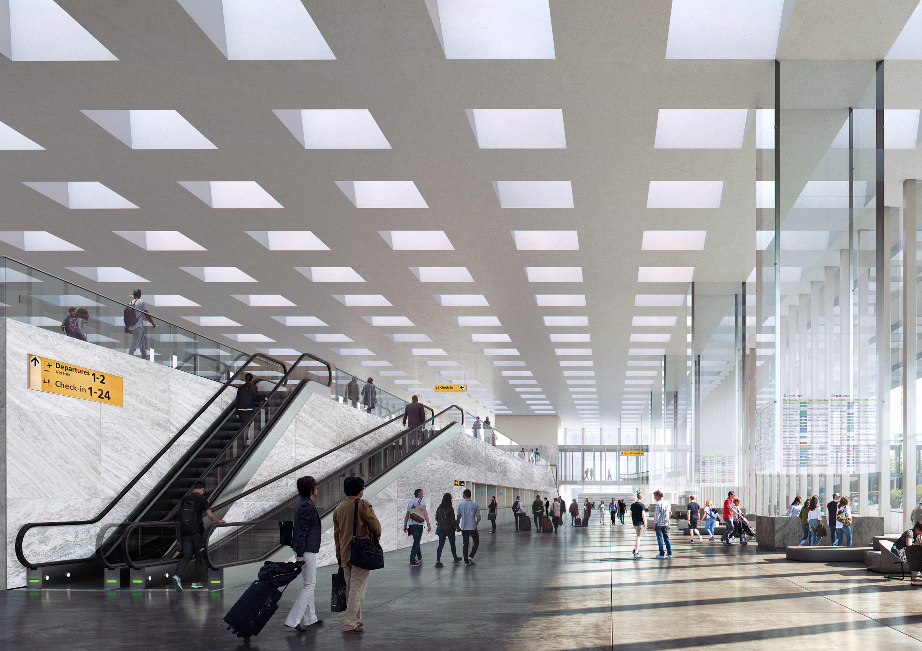

Slide 15
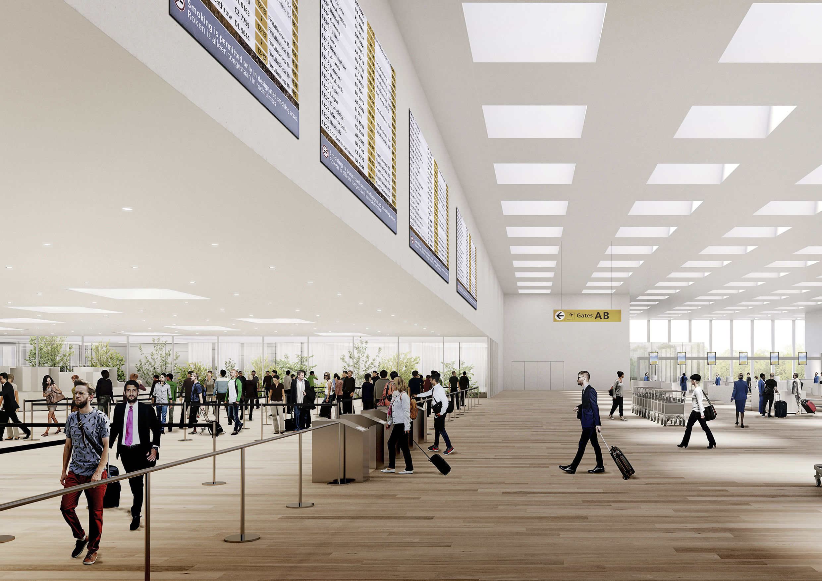

Slide 16
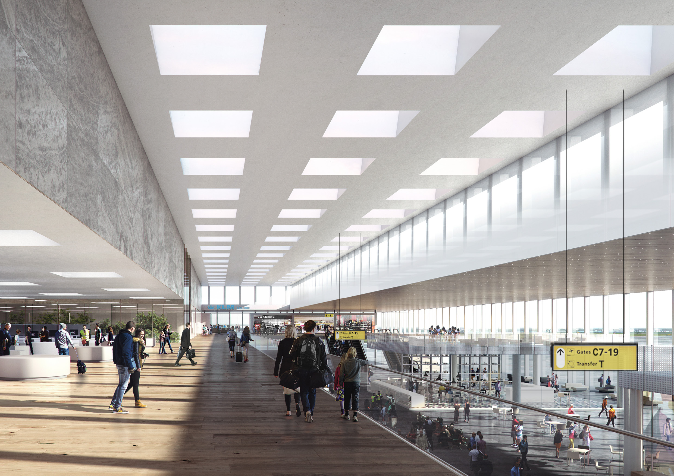

Slide 17
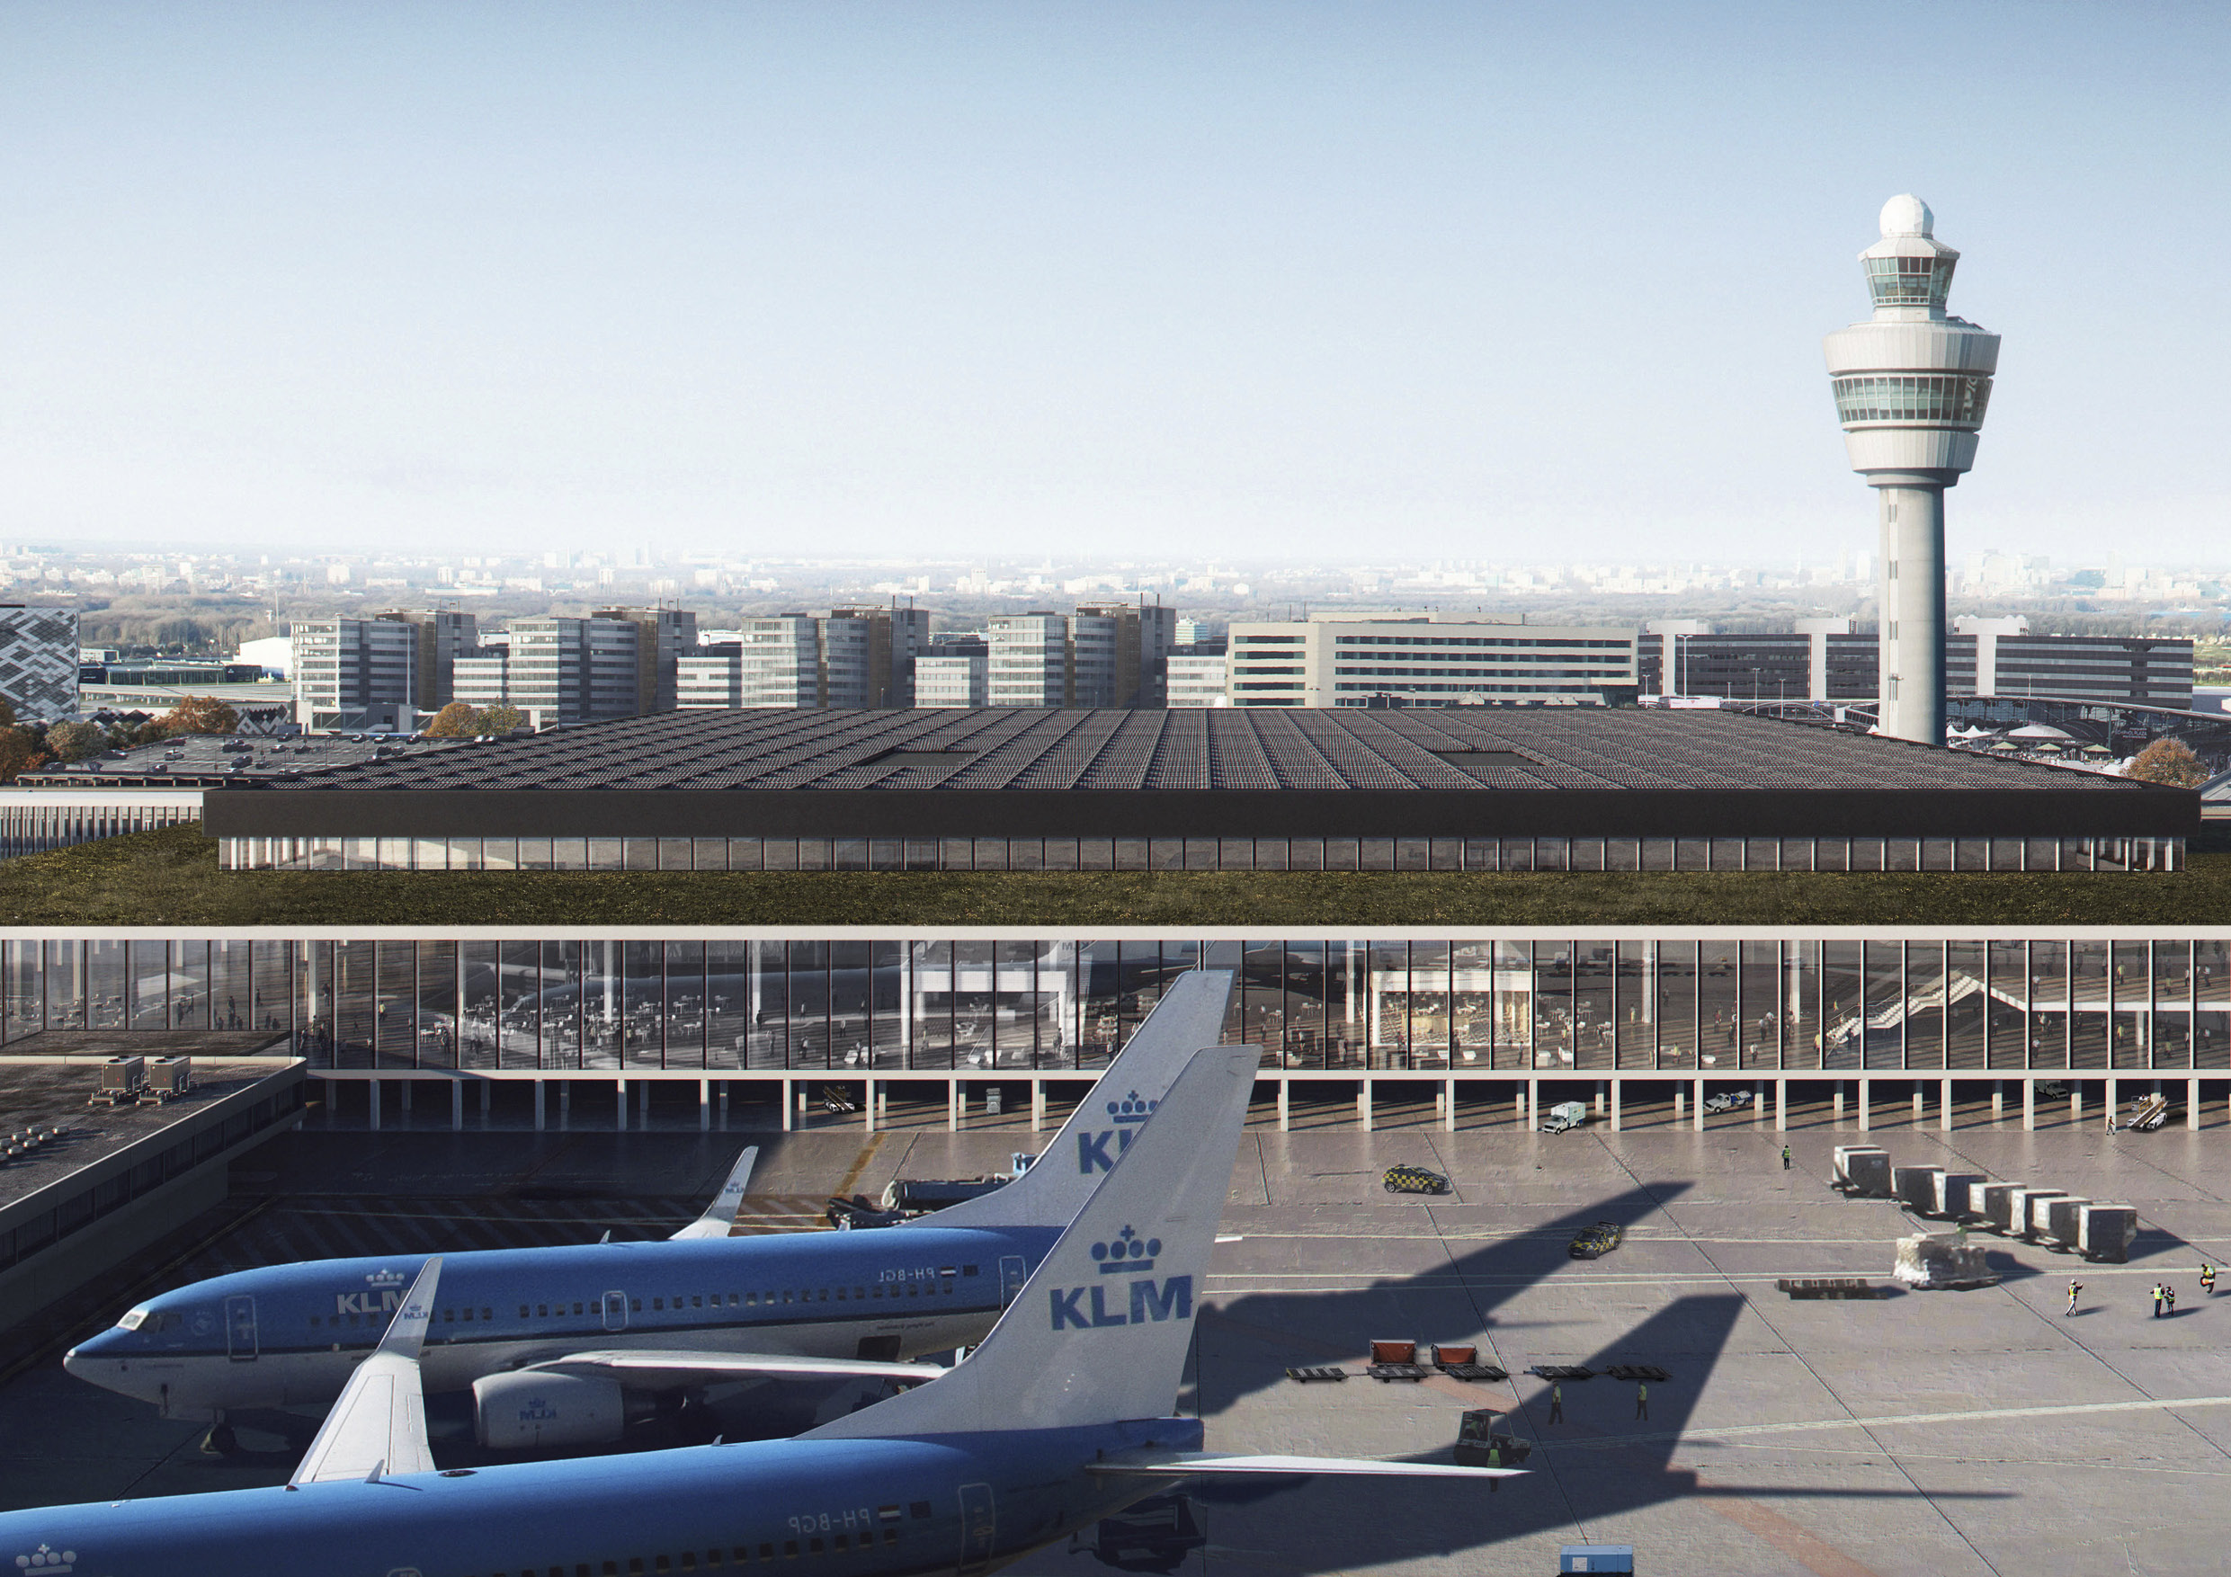

Slide 18
