Slide 1
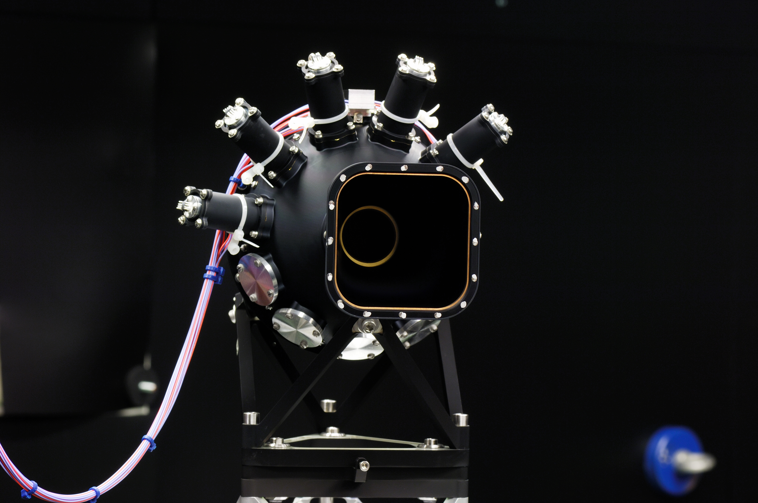
Market consultation CSI Mechanical Manipulation System
TNO

Slide 2
Outline
Introduction
Manipulation needed
Boundaries
Option 1: manipulation all in vacuum
Option 2: manipulation in atmosphere

Slide 3
Introduction TNO
Article 4 TNO Act
The Organisation aims to ensure that applied engineering and scientific research and other associated social scientific and applied research is made suitably serviceable for the general good and the distinctive interests contained therein.
TNO Mission:
TNO connects people and knowledge to create innovations that boost the competitive strength of industry and the wellbeing of society in a sustainable way.
Although TNO is mentioned in the constitution of the Netherlands.
TNO is independent

Slide 4

Introduction TNO
The power of TNO
From idea to innovation

Slide 5
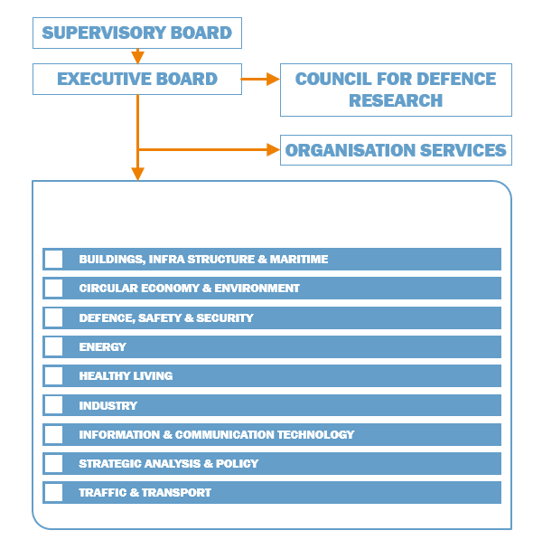
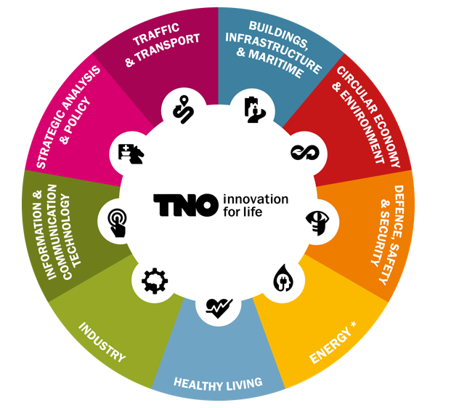
Introduction TNO
Department
Space Systems Engineering

Slide 6

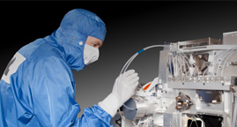
INDUSTRY, example project
  TROPOMI WILL ANSWER PRESSING QUESTIONS ABOUT CLIMATE CHANGE
APPROACH
  Collaboration with Airbus Defence & Space Nederland, KNMI and SRON, funded by the ministries of Economic Affairs, Education, Culture & Science, and Infrastructure & Water Management
  Innovative optics allows high resolution in a compact unit
RESULT
  Within one second pinpoint clearly a strip of 2600 m by 3.5 km and thereby assess the air quality at urban level
  Help answer pressing questions on climate change
  Strengthening the position of the Netherlands as space instrumentation supplier
CHALLENGE
  Even more specific measurements from space of the air quality and distribution of greenhouse gases worldwide

Slide 7
Introduction CSI
TNO is investing in a new Thermal Vacuum Chamber facility for Calibrating Space Instruments
This new facility (the “CSI”) will consist of a vacuum chamber (horizontal cylinder of about 3 m diameter and 4 m length), an optical stimulus (also known as OGSE) unit (inside the vessel) and a mechanical manipulation system to position and align inside the vessel the optical stimulus and the instrument to calibrate.
For the Thermal Vacuum Chamber a European tender is foreseen, to be published mid June 2018.
For the mechanical manipulation a tender is foreseen as well, preceded by a (this) market consultation.
The mechanical manipulation solution(s) will have an impact on the design of the vacuum vessel.

Slide 8
Manipulation needed
Top view
Rotation +/- 180° at instrument location
Tilt of instrument +/- 5°, wish +/- 7.5°
X and Y +/- 250 mm at instrument, or at OGSE, or combined at both locations
instrument
side view
instrument
Top view
side view
Instrument/ OGSE
Instrument/ OGSE

Slide 9
Boundaries
OGSE weight > 100 kg, <200 kg
  Maximum dimensions 1 by 1 by 2 meter
Instrument weight < 160 kg
  Maximum dimensions 1.2 by 1.2 by 0.6 meter (volume claim due to rotation is cube of 1.2 m)
Expected is that rotation of instrument is done with an in-vacuum rotation table
Operation temperature: -60°C (TBD) to + 45°C
Non operation temperature: -XX°C to + 120°C
  Counter measures for temperature are allowed, please put forward these counter options
Positioning of instrument to OGSE relative to each other shall preferably be controlled by manipulation system
Z-axes is the optical axes of the system

Slide 10
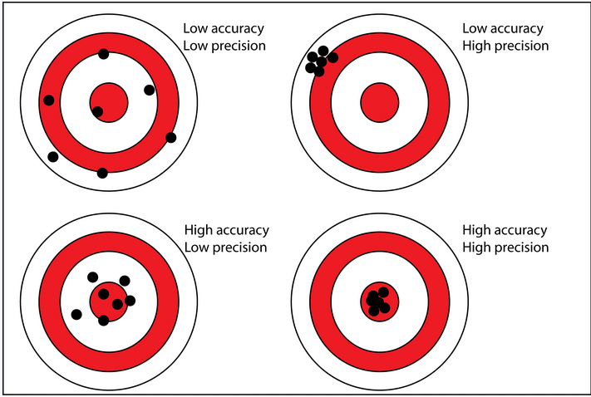
Boundaries
Positioning accuracy, stability and knowledge
requirements on instrument and OGSE relative position:
  X/Y positioning accuracy: 1 mm
  X/Y stability: 1 mm
  X/Y knowledge: 1 mm
  Rotation/Tilt positioning accuracy : <0.01° (TBD)
  Rotation/Tilt stability : <0.001° (TBD)
  Rotation/Tilt knowledge : <0.001° (TBD)
Expected solutions are combinations of the following manipulation options:
  Hexapod in vacuum
  Hexapod outside vacuum, with bellows as barriers between atmosphere and vacuum
  XY stage (left-right, up-down)
  (vacuum) gimbal for tilt
  (vacuum) rotation table

Slide 11
Option 1: manipulation all in vacuum
Side-view
instrument
OGSE
Anti-vibration table
mechanical
manipulators
Flexible bellow as vibration isolator
Note: bellow cannot withstand a rotation force

Slide 12
Option 2: manipulation in ambient
Side-view
instrument
OGSE
Flexible bellow as feed through for manipulation and vibration isolator
Note: bellow cannot withstand a rotation force
mechanical
manipulators

Slide 13
Thank you for your attention
Take a look:
  TIME.TNO.NL

