Slide 1
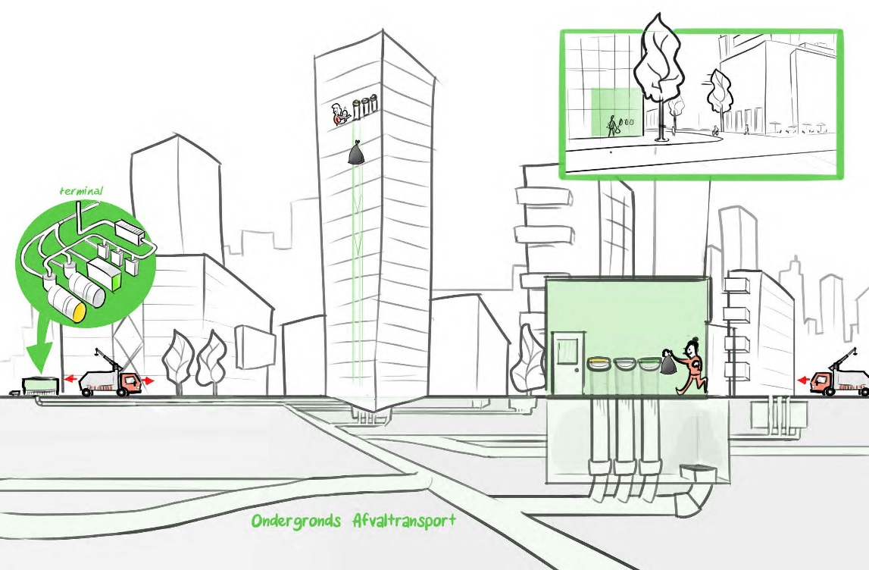
Automated Waste Collection System (AWCS)
Amsterdam Sluisbuurt
Market consultation

Slide 2
Contents
  Location Zeeburgereiland and Sluisbuurt
  Program information Sluisbuurt
  Why an AWCS for the Sluisbuurt?
  Planning
  Starting points: procurement
  Starting points: technical
  Starting points: AWCS
  Risk assessment and control
  Disclaimer
  Involved parties
  Appendix: planning, competitive procedure with negotiation
  Risk assesment and control
Presentation market consultation Automated Waste Collection System (AWCS) Amsterdam Sluisbuurt
10-8-2017
| 2

Slide 3
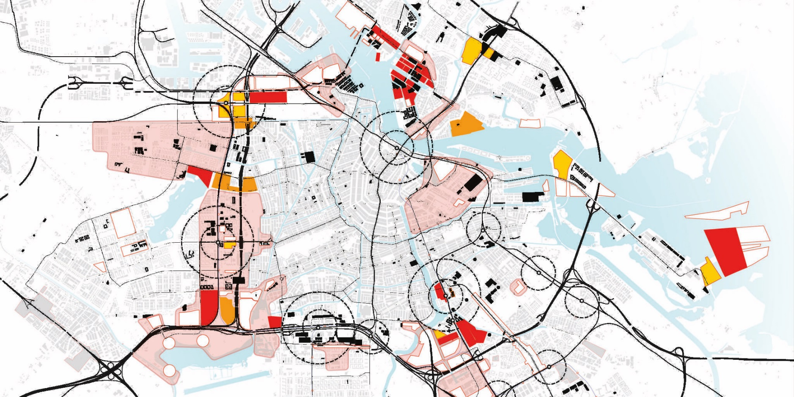
1. Location – Amsterdam

Slide 4
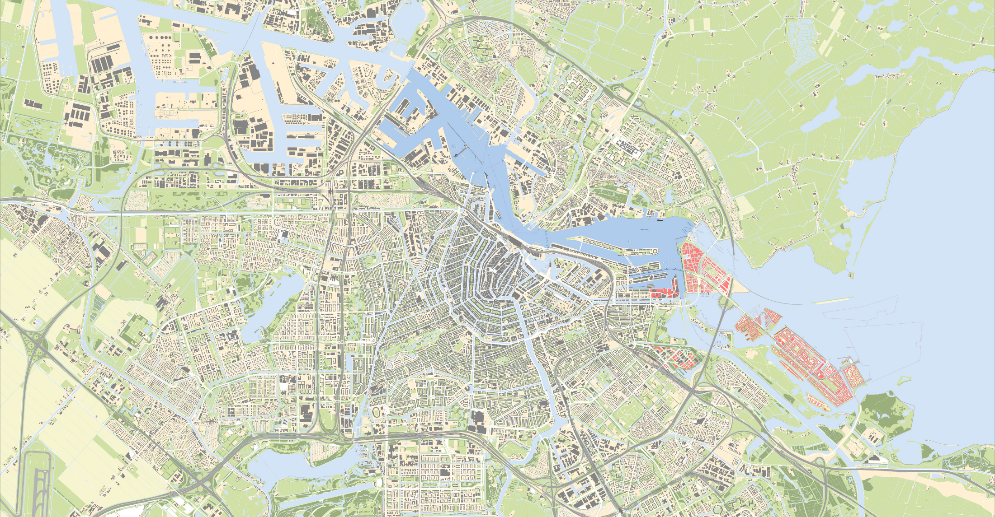
1. Location – East side of Amsterdam

Slide 5
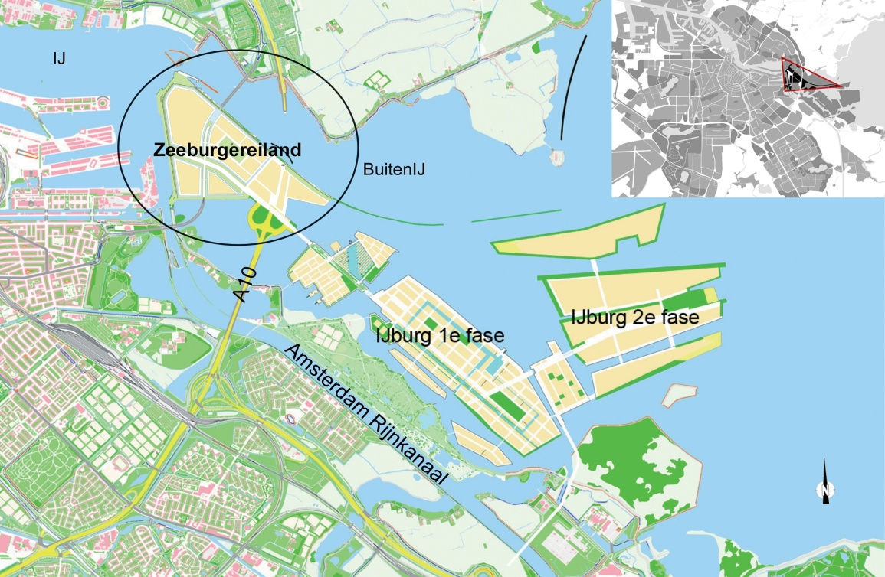
1. Location Zeeburgereiland and Sluisbuurt (1)

Slide 6
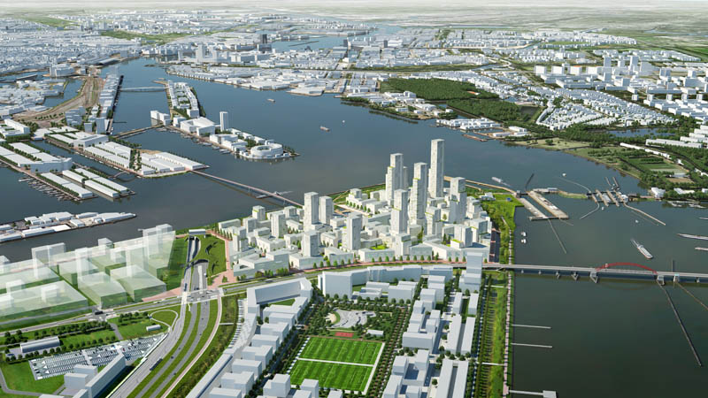
1. Location Zeeburgereiland and Sluisbuurt (2)

Slide 7
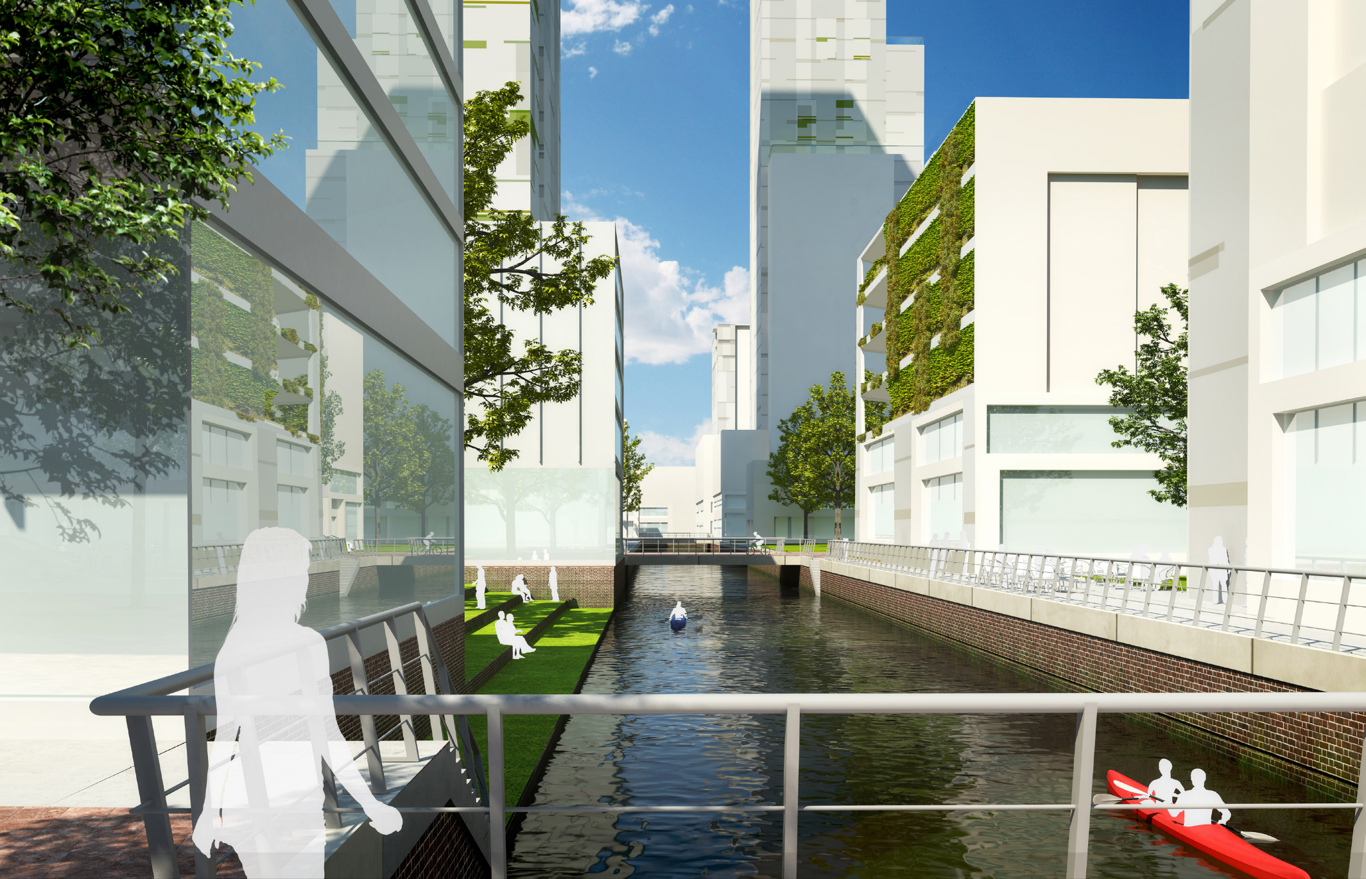
Artist Impression

Slide 8
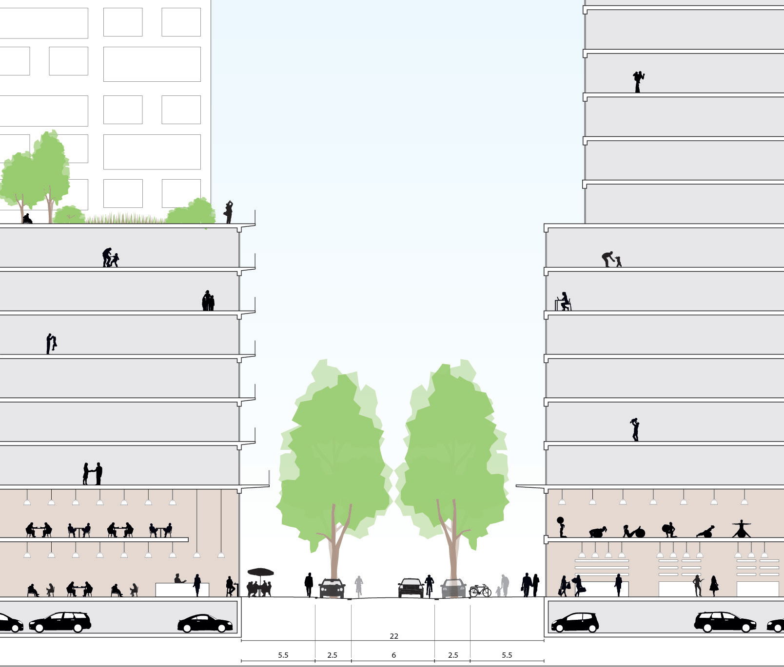
Artist Impression

Slide 9
2 Program information Sluisbuurt (1)
  Building surface: 28,3 ha;
  5,500 new homes, approx. 10.000 inhabitants;
  100.000m² space for schools, offices and shops;
  High living density: residential towers up to 140m;
  Homes/ha: 200;
  Floorspaceindex: 2.2;
  Floorspacindex per lot: 4.3;
Presentation market consultation Automated Waste Collection System (AWCS) Amsterdam Sluisbuurt
10-8-2017
| 9

Slide 10
2 Program information Sluisbuurt (2)
Fraction | Traditional Ton per year | AWCS Ton per year
Residual waste | 4,129 | 2,680
Organic | 4 | 623
Paper, cardboard | 1,108 | 1,386
Plastic, metal waste, cardboard drink packaging (PMD) | 27 | 451
Total | 5,267 | 5,140

Slide 11
3 Why a AWCS for the Sluisbuurt? (1)
Sustanability policy for waste collection
  Enhancement for separtion of waste collection from 27% waste in 2014 to 65% in 2020;
  Seperation of waste at the source;
  The waste department is looking for new ways to reach these goals and wants to improve service
Presentation market consultation Automated Waste Collection System (AWCS) Amsterdam Sluisbuurt
10-8-2017
| 11

Slide 12
3 Why a AWCS for the Sluisbuurt? (2)
Spatial policy
  Priority will be given to pedestrians and cyclist when dividing scarce public spaces;
  There will be as less static functions in public space as possible. This means we will be reluctant with parking space, waste containers, kiosks, etc
  AWCS (inside buildings) helps to reduce pressure on public space
Presentation market consultation Automated Waste Collection System (AWCS) Amsterdam Sluisbuurt
10-8-2017
| 12

Slide 13
4 Planning (1)
Destination plan: februari 2019 -> award OAT and start building OAT
Between februari 2019 and now:
    November 2017: Investment decicion council of Amsterdam;
    May 2018: Definite approaval for tender and start tendering procedure ;
Presentation market consultation Automated Waste Collection System (AWCS) Amsterdam Sluisbuurt
10-8-2017
| 13

Slide 14
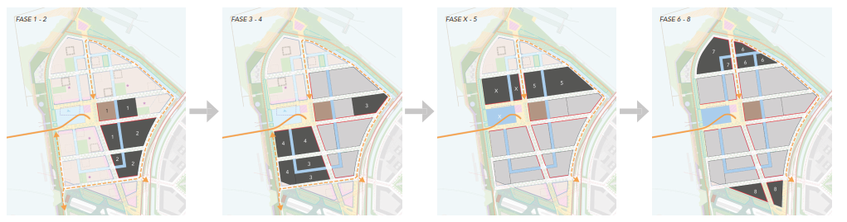
4 Planning (2)

Slide 15
5 Starting point: procurement (1)
tendering procedure: competitive procedure with negotiation.
  The contracting authority, city of Amsterdam, has sufficiënt information to specify the requirements for the contract but not enough knowledge to specify the optimal design solution

Slide 16
5 Starting point: procurement (2)
Contract: DBM(F)O
Maintain and Operate: 30 – 50 years
Dutch contracting standarts: UAV-GC and DNR
Contract name and number:
AI 2017-0278 Ondergronds Afval Transportsysteem Sluisbuurt

Slide 17
6 Starting points: technical
  Settlement of the soil of maximum 30 cm in 30 years
  No settlement of bridges and buildings (foundation on poles)
  No first sand layer at part of the island
  Ground water level: approx. 0.5m below surface
  Soil structure:
    1-2m sand top layer
    12-20m clay and peat (varies throughout the eara)
    First sandlayer starts at: 12-20m below surface (varies throughout the eara)
Presentation market consultation Automated Waste Collection System (AWCS) Amsterdam Sluisbuurt
10-8-2017
| 17

Slide 18
6 Starting points: AWCS
  Pipe diameter 400 mm
  Inlets approximate 270
  Terminal situated near Piet Hein tunnel or Bedrijvenstrook
Presentation market consultation Automated Waste Collection System (AWCS) Amsterdam Sluisbuurt
10-8-2017
| 18

Slide 19
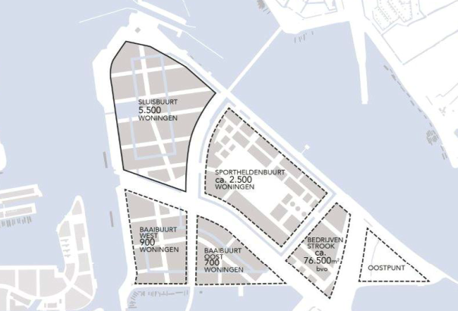
1
2
Presentation market consultation Automated Waste Collection System (AWCS) Amsterdam Sluisbuurt

Slide 20
7 Risk assessment and control (1)
We have the following questions about risks
  Are there more risks we should take in to consideration?
  Do you agree with the deviding of the risk as proposed?
  Are you able to bear this risk (to what extent)?
  If not: why not? What has to change to bear this risk (more detailed requirements, a financial limit etc.)

Slide 21
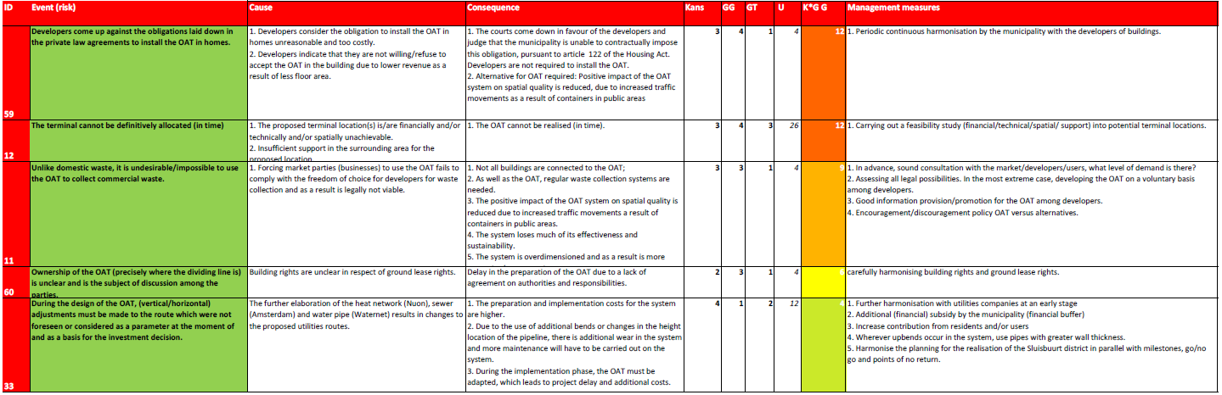
7.1 Preparation phase
Presentation market consultation Automated Waste Collection System (AWCS) Amsterdam Sluisbuurt

Slide 22
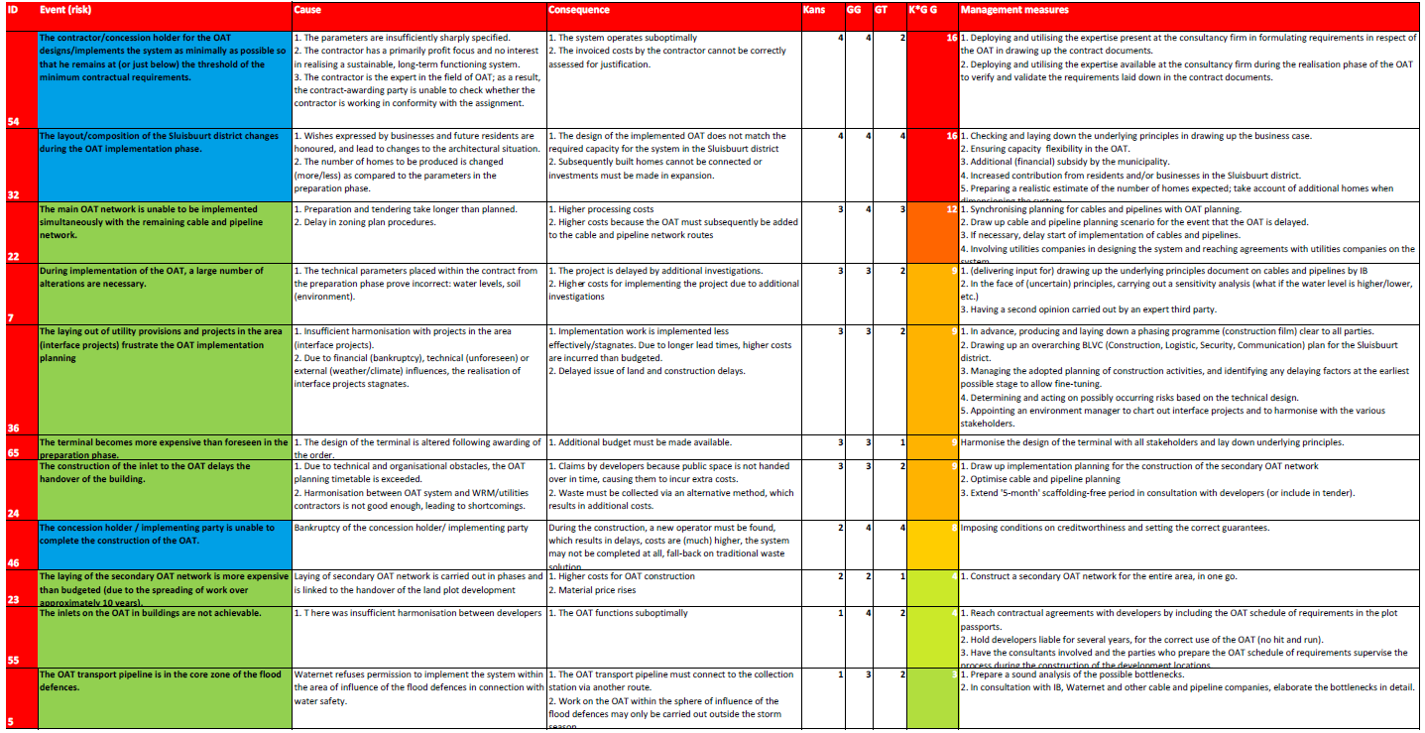
7.2 Realization phase
7.1 Realization phase

Slide 23
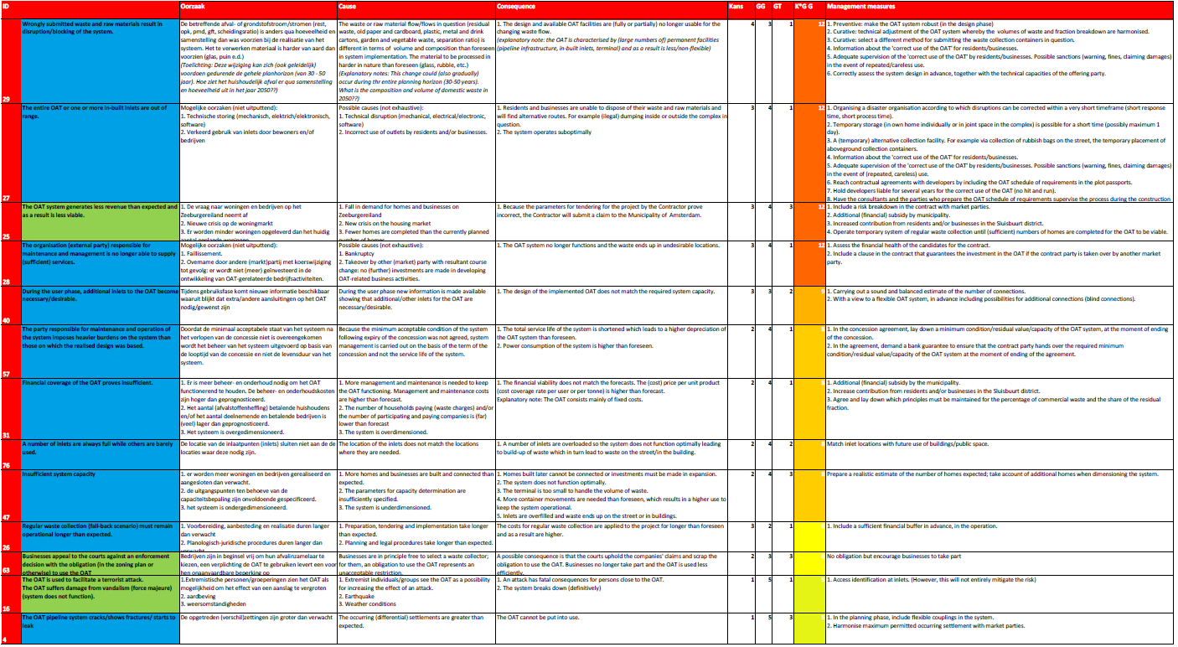
7.3 Exploitation phase
Presentation market consultation Automated Waste Collection System (AWCS) Amsterdam Sluisbuurt

Slide 24
8 Disclaimer
No rights can be obtained from the information provided in this presentation or from information given by words during this market consultation.
This presentation will be publised at TenderNed after the presentation has been given.

Slide 25
9 Involved parties
- Council of Amsterdam
- Sweco (external advisors; Sweco doesn’t take part of the tender for building the AWCS);
- Tauw: (external advisors; Tauw doesn’t take part of the tender for building the AWCS);
- RHDHV: (external advisors; RHDHV doesn’t take part of the tender for building the AWCS);

Slide 26
Appendix
Competitive procedure with negotiation
(mededingsprocedure met onderhandelingen )
Directive 2014/24/EU article 29
http://eur-lex.europa.eu/legal-content/EN/TXT/HTML/?uri=CELEX:32014L0024&from=NL
Dutch Law: Aanbestedingwet articles 2.30 and 2.31
http://wetten.overheid.nl/BWBR0032203/2016-07-01#Deel2

Slide 27
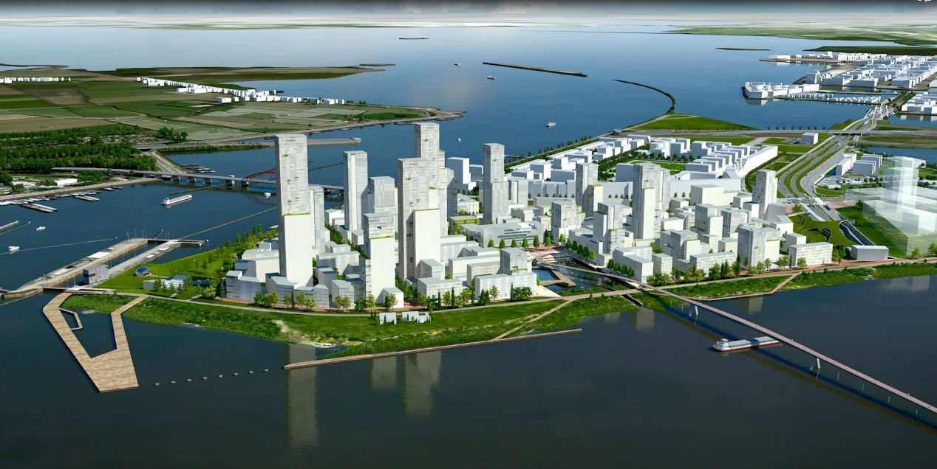

Slide 28
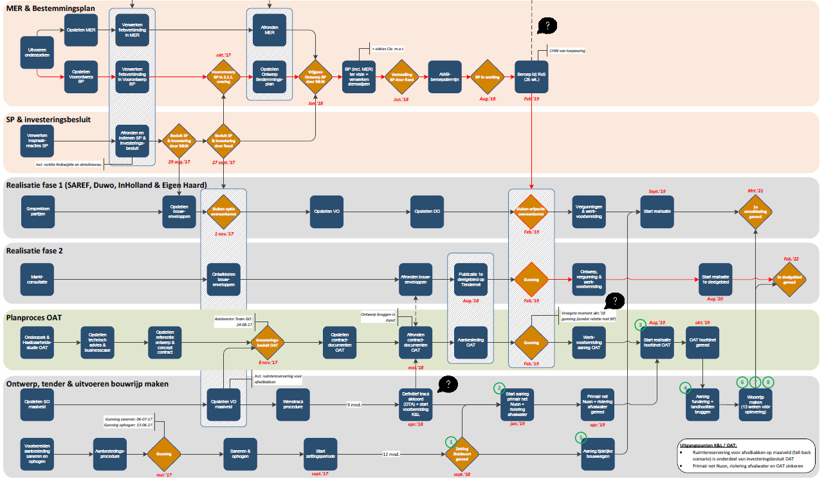
planning

